Slide 1

Online Cloud Compiler (ONCC)
Capstone Project (CS691/CS692)
Presented by Debug Entity

Slide 2



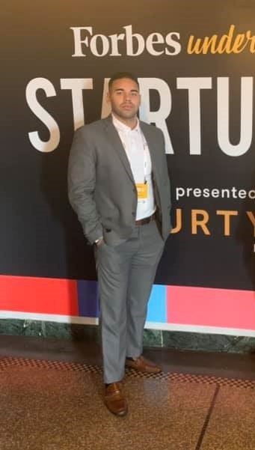


Roles and Responsibilities
Harshada Chaudhary:
Frontend Developer/Designer
Integrated HTML/CSS web pages in Flask
Connected user database with Flask.
Designed user interactions in web pages.
Anchal Singh:
Product Owner/Project Manager
Defined stories and prioritized the product backlog.
Evaluated product progress at each iteration.
Maintained and authored technical documentation and GitHub.
Ramesh Kyasaram:
Frontend Developer/Tester
Designed web page layout in HTML/CSS.
Tested different complier modules.
Ensured quality of the developed product.
Brandon Mercado:
AWS Cloud Engineer, Solution Architect
Designed, managed and maintained technological duties associated with AWS Cloud.
Sanath Gholap:
Scrum Master/Tester
Conducted weekly standups with team members and delegated tasks.
Assisted team in documentation, handling GitHub related tasks.
Tested compiler modules and their integration with frontend.
Tushar Rakholiya:
Fullstack Developer (Lead)
Researched and implemented backend technologies.
Monitored servers and databases for
functionality.
Ensured responsiveness of application.

Slide 3
Agenda
Project Overview
Project Requirements
User Personas
Tools and Technologies
Front-end, Backend Technologies and Database
AWS Services
Tools
System Architecture
Sequence Diagram
Database Migration
AWS diagram
Sprint 1-4 Recap
Committed and Completed Artifacts
Statistics
Test Cases
Burndown Charts
Sprint 8 Report
Committed and Completed Artifacts
Statistics
Test Case
Sprint 8 Burndown Chart
Sprint 8 Deliverables
Retrospective
Conclusion
Demo
Sprint 5-7 Recap
Committed and Completed Artifacts
Statistics
Test Cases
Burndown Charts

Slide 4
Project Overview
This application is a cloud-based compiler facilitated with five most demanding programming languages such as Java, Python, C/C++ and C#.
The main objective is achieved in this application is to develop a centralized compiler that helps to reduce problems like portability storage, cost, and space etc.
It is the most convenient tool to write and compile code, download, share and save code. Moreover, we can run the web-based application remotely from any network connection that is independent of platform.
Therefore, this Cloud based application benefits user to access the compiler online being at any network instead of installing different IDEs on each machine.

Slide 5
Project Requirements
Functional Requirements
Usability Requirements
Choosing options for programming languages C/C++, Java, Python and C#
Compile code
Input code
Display output
Save/Share code
Download code

Slide 6

Persona 1
PICTURE & NAME | DETAILS | GOAL
Name: Dan William Age: 24 Designation: Student | Role: Student Dan is a Student at Pace University. As an Information Technology student, he is struggling to learn and practice at least two most demanding computer languages so that he can prepare for his interviews to crack coding assessments by practicing his skills at a single platform which is available online where he can write, test and save his code without wasting extra memory space of his computer and save time as well. He can subscribe an online compiler platform, write, save and share the codes for future use. | He wants to get rid of installing multiple IDE’s and save his time to practice his coding skills for the assessment tests. Also, he wants to save it for later use.

Slide 7

Persona 2
PICTURE & NAME | DETAILS | GOAL
Name: Ethan Coufal Age: 30 Designation: Software Developer | Role: Software Developer Ethan is an independent mother of her single child. She is a struggling software developer working from home. She has to code in java as well as she has got a task to learn python from her company. But she barely has time to download multiple IDEs to learn, test and save her code simultaneously by keeping in mind the storage space of her computer. | She needs a single platform where she can write, test and save her code without wasting the memory of her PC. So that, she can save the time and access her code for long term by saving the code.

Slide 8

Persona 3
PICTURE & NAME | DETAILS | GOAL
Name: John McCarthy Age: 27 Designation: Student | Role: Student John is a student at Pace University. Being a Graduate student in Computer Science, writing and compiling codes in different languages is part of his daily life. Sometimes, He finds it difficult to get the subscription for different IDEs because it’s costly and time consuming. It will become more costly if he will take subscription for all different IDEs for each coding languages. Therefore, he yearns for a single platform where he can compile, run and save time at least more frequently used languages (Java, Python, C#, C, C++) at the same platform by making the coder’s life easier. | He wants a different compiler at single platform, where he can compile at least more frequently used languages (Java, python, C#, C/C++) to make his coding life easier and save time.

Slide 9
Tools and Technologies
Front-end, Back-end and Database Technologies
AWS Services
Other Tools

Slide 10
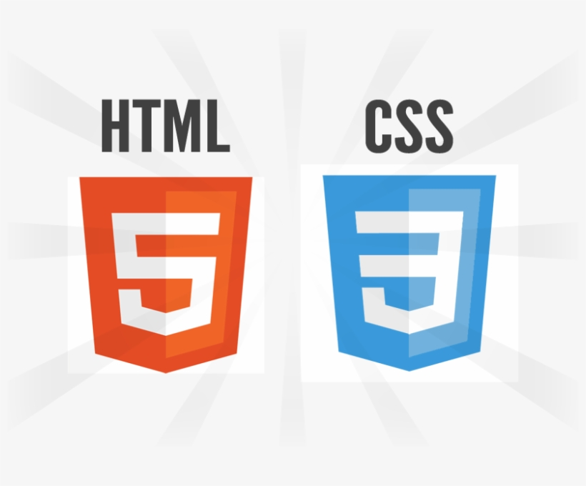


Front-end, Back-end and Database Technologies
To style the page contents and make the web application interactive.
A lightweight framework to make web application creative and flexible in accessing.
MongoDB is NOSQL database, more suitable with Python (flask), and fast to store and retrieve data from it.

Slide 11
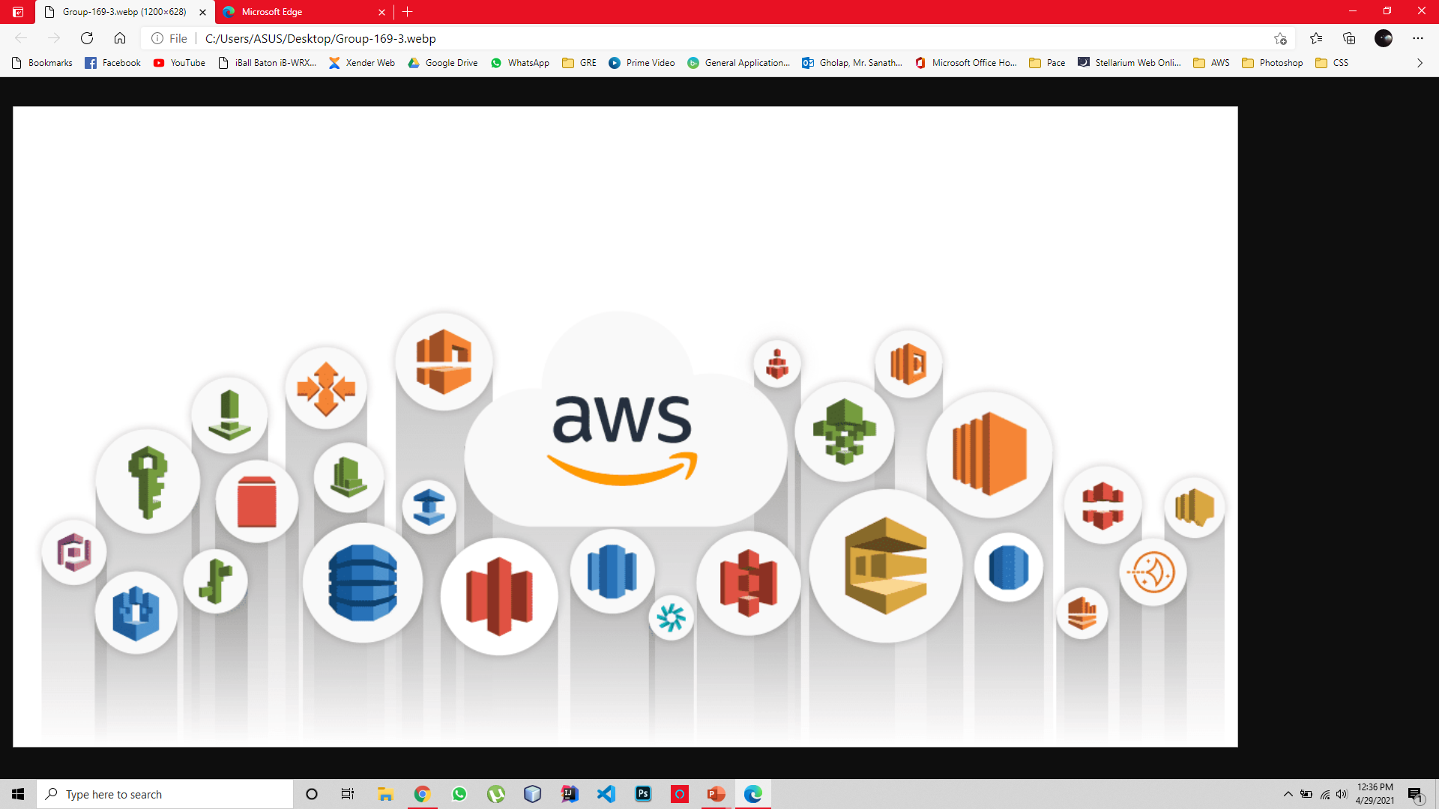
AWS Services
AWS S3 Bucket
AWS EC2
AWS DynamoDB
AWS IAM
Authy
Boto3
Easy to store and retrieve any amount of data at any time.
EC2 provides you with complete control of your computing resources and lets you run on Amazon’s proven computing environment.
DynamoDB is an Amazon Web Services database system that supports data structures and key-valued cloud services.
AWS Identity and Access Management (IAM) enables you to manage access to AWS services and resources securely.
Authy is a two-factor authentication tool to provide security.
Boto3 is an AWS SDK for Python to manage AWS Services such as S3 bucket and EC2 instance.

Slide 12


Other Tools

Slide 13
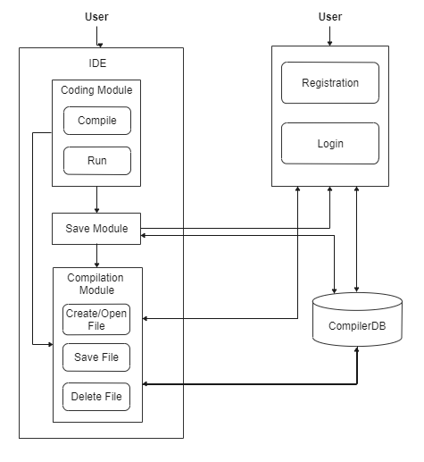
System Architecture

Slide 14
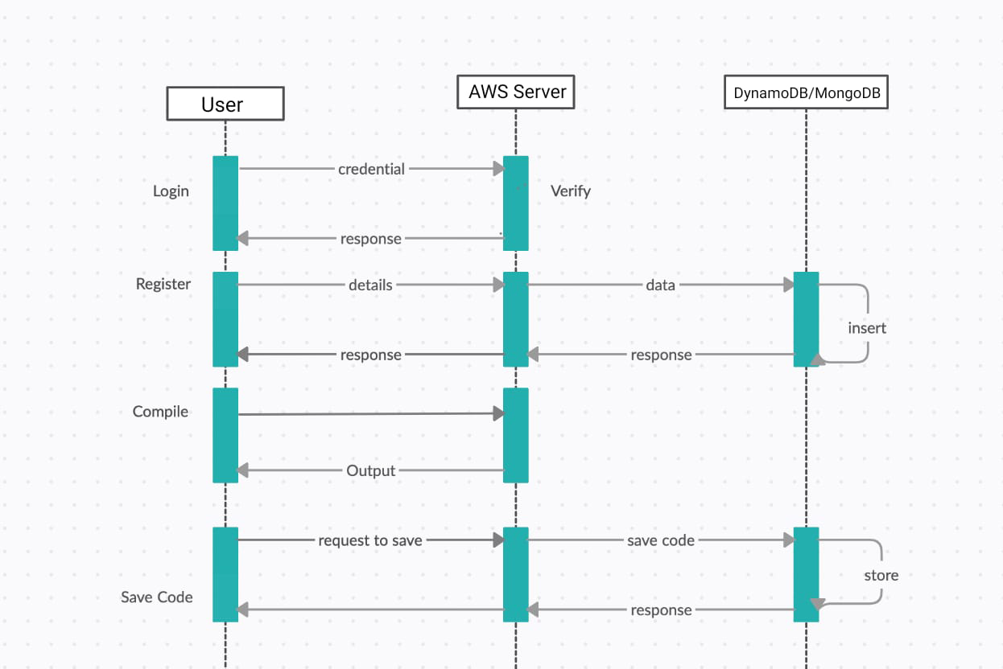
Sequence Diagram

Slide 15
AWS System Architecture

Slide 16
CS-691 Sprint 1-4 Recap

Slide 17
Sprint 1 Artifacts
Issue Type | ID | Summary | Priority | Status | Expected Hours | Total Hours (Completed)
Task | ONCC-2 | Requirement Gathering | High | Done | 10 | 10
Task | ONCC-4 | Project Planning | High | Done | 8 | 6
Task | ONCC-1 | Research on Project topics | Medium | Done | 20 | 20
Task | ONCC-3 | Discuss and Research Database Design | Medium | In-Progress | 6 | 3
Task | ONCC-5 | Task Allocation to each team member | Low | Done | 4 | 4
Sprint 1 Goal:
Finalize project requirements
Assign tasks to team members

Slide 18
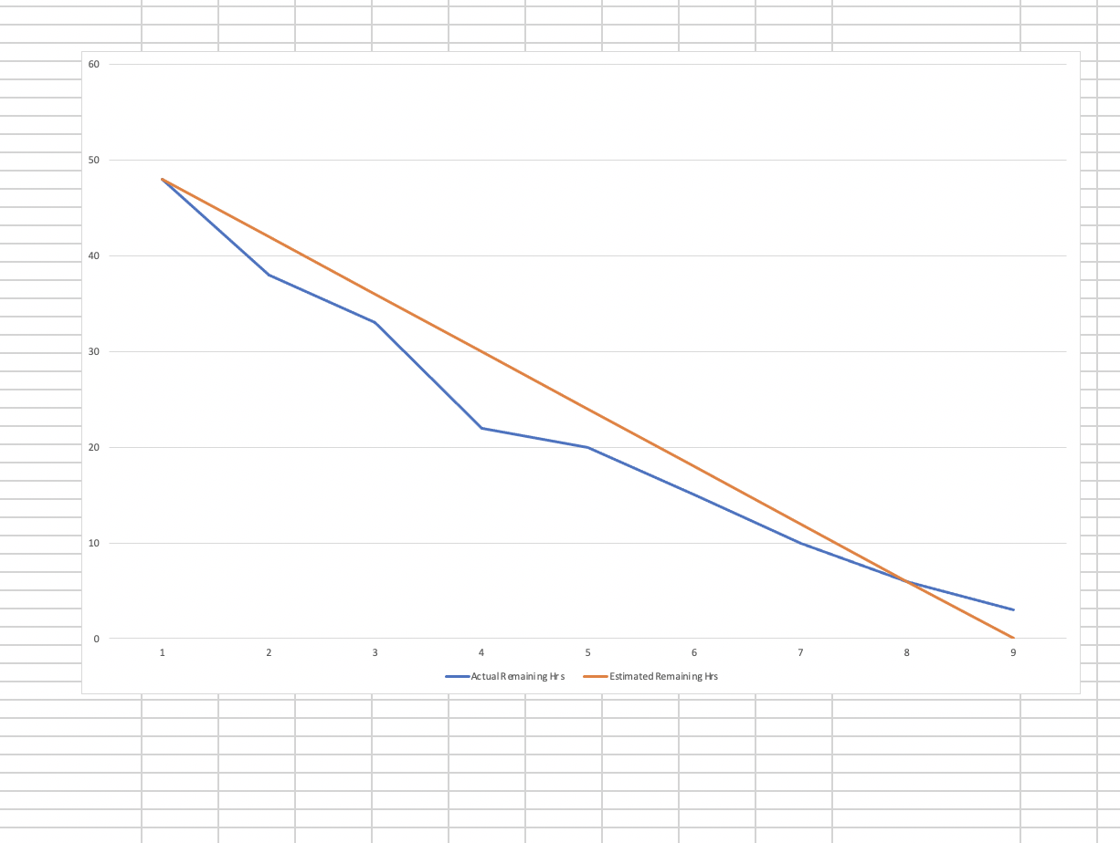
Sprint 1 Hours Burndown
September 04, 2020 - October 18,2020
We used Excel sheet to express our burndown charts.
This chart is based on Total Hours
Expected Hours=48
Completed Hours=45
Remaining Hours=3
Completed Artifacts (hours)= 94%
We have moved ONCC-3 task in Sprint-2

Slide 19
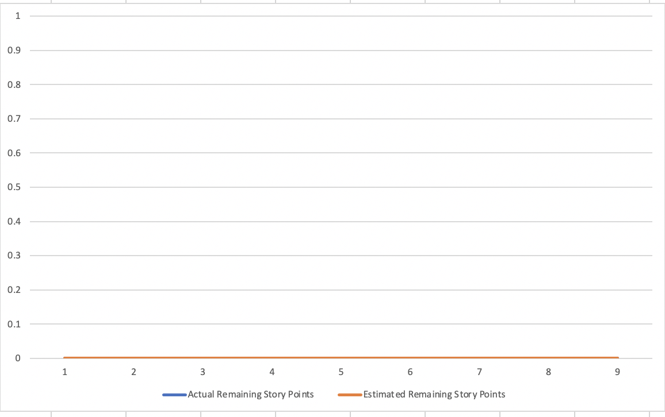
Sprint 1 Burndown (Story Points)
September 04, 2020 - October 18,2020
We don’t have any user stories for Sprint 1
Velocity =0

Slide 20
Sprint 2 Artifacts
Issue Type | ID | Summary | Priority | Status | Expected Hours | Total Hours (Completed)
Task | ONCC-3 | Discuss and Research Database Design | High | Done | 3 | 3
Task | ONCC-8 | Initialize Web Application | High | Done | 7 | 7
Task | ONCC-10 | Research about the compiler module | High | Done | 8 | 8
Task | ONCC-7 | Finalizing Database | Medium | Done | 6 | 6
Task | ONCC-9 | Research about the Cloud Service to be used. | Medium | Done | 3 | 3
Task | ONCC-6 | Learning Python Flask | Medium | Done | 8 | 8
Sprint 2 Goal:
Research about Database, front-end and Compiler technologies.
Learn about compiler and Python(Flask)

Slide 21
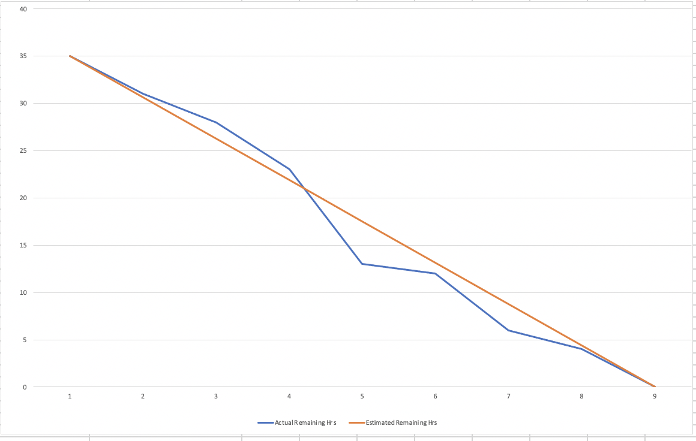
Sprint 2 Hours Burndown
September 23, 2020 - October 05, 2020
We used Excel sheet to express our burndown charts.
This chart is based on Total Hours
Expected Hours=35
Completed Hours=35
Completed Artifacts (hours) = 100%

Slide 22
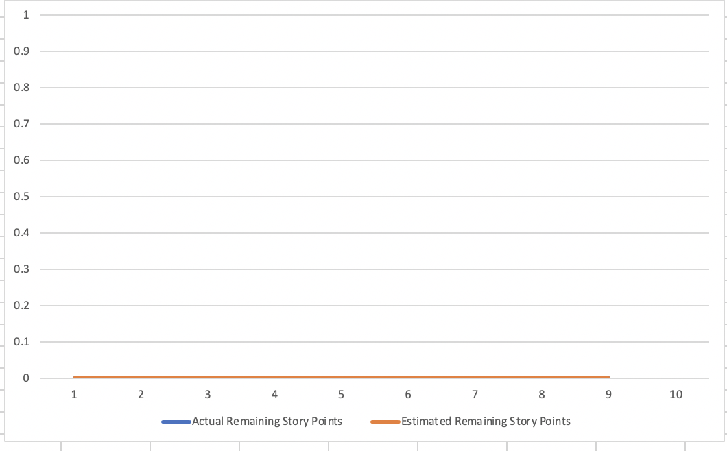
Sprint 2 Burndown (Story Points)
September 23, 2020 - October 05, 2020
We don’t have any user stories for Sprint 2
Velocity = 0

Slide 23
Sprint 3 Artifacts
Issue Type | ID | Summary | Priority | Status | Expected Hours | Total Hours (Completed Hours)
Task | ONCC-11 | Initiate the compiler module with python | High | Done | 15 | 15
Task | ONCC-12 | Database Design | High | Done | 6 | 6
Task | ONCC-13 | Create database table for user and registration | High | Done | 5 | 5
Task | ONCC-14 | Design login page | Medium | Done | 4 | 4
Task | ONCC-15 | Design Registration page | Medium | Done | 4 | 4
Task | ONCC-16 | Connection between web application and database | Medium | Done | 6 | 6
Task | ONCC-17 | Initiate the REST API development-GET command | Medium | Done | 5 | 5
Sprint 3 Goal:
Design login and Registration Page
Create User Table in MongoDB
Connect web application with MongoDB

Slide 24
Sprint 3 Test Cases
Test Cases for | ID | Steps | Test Scenario | Test Data | Expected Results | Actual Results | Pass/Fail
Registration | ONCC-15 | 1 | Check registration form with First name | Sanath | NO Validation Errors | NO Validation Errors | PASS
 |  | 2 | Check registration form without first name | *Blank* | Validation Errors | Validation Errors | PASS
 |  | 3 | Check registration form with Last name | Gholap | NO Validation Errors | NO Validation Errors | PASS
 |  | 4 | Check registration form without Last name | *Blank* | Validation Errors | Validation Errors | PASS
 |  | 5 | Check registration form with vaild email | sanath2097@gmail.com | NO Validation Errors | NO Validation Errors | PASS
 |  | 6 | Check registration form without email | *Blank* | Validation Errors | Validation Errors | PASS
 |  | 7 | Check registration form with Password | testpassword | NO Validation Errors | NO Validation Errors | PASS
 |  | 8 | Check registration form without Password | *Blank* | Validation Errors | Validation Errors | PASS
 |  | 9 | Check registration form with invalid email | sanathgholap.com | Validation Errors | Validation Errors | PASS
 |  | 10 | Check registration form with confirming Password | *Wrong password in confirm field* | NO Validation Errors | NO Validation Errors | PASS
Compiler | ONCC-11 | 1 | Choosing the language from the drop-down menu with selecting a language | Java/Python/C/C++/C# | NO Validation Errors | NO Validation Errors | PASS
 |  | 2 | Choosing the language from the drop-down menu without selecting a language | *Blank* | Validation Errors | Validation Errors | PASS

Slide 25
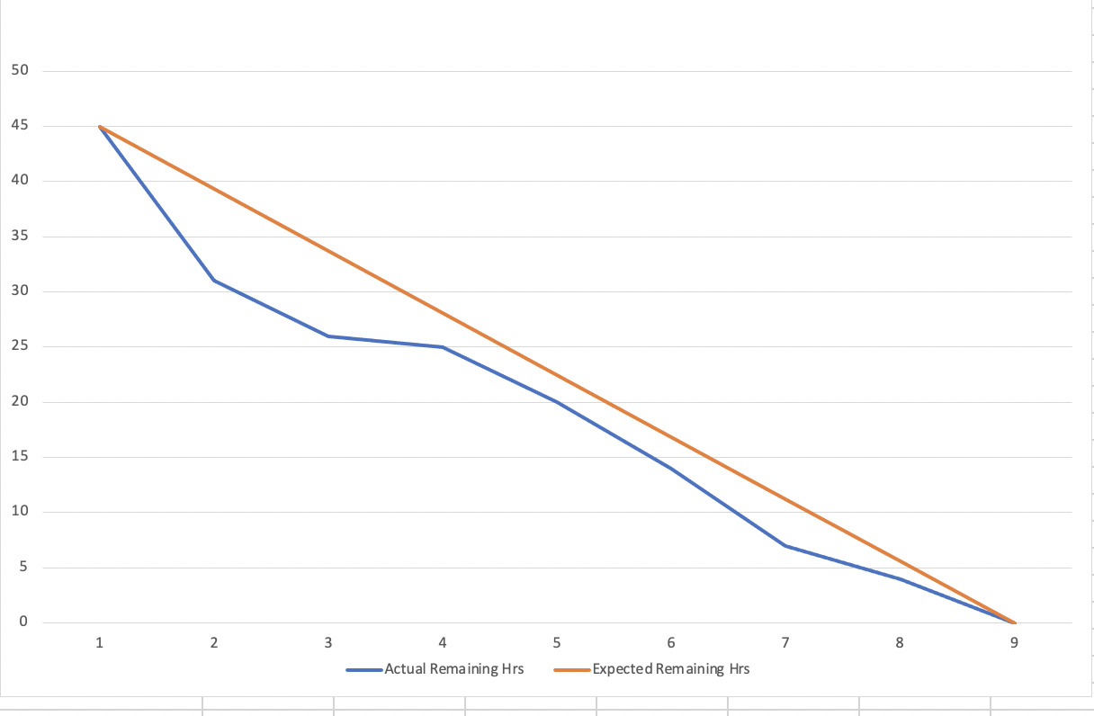
Sprint 3 Hours Burndown
October 6, 2020 - October15, 2020
We used Excel sheet to express our burndown charts.
This chart is based on Total Hours
Expected Hours=45
Completed Hours=45
Completed Artifacts (hours) = 100%

Slide 26
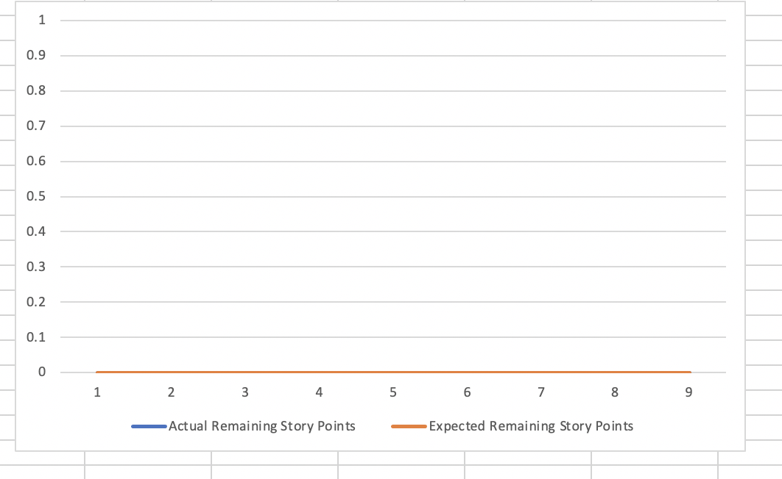
Sprint 3 Burndown (Story Points)
October 6, 2020 - October15, 2020
We don’t have any user stories for Sprint 3
Velocity = 0

Slide 27
Sprint 4 Artifacts
Issue Type | ID | Summary | Priority | Status | Story Points
Story | ONCC-19 | As a Guest User, I want to have an option to select Java programming language so that I can compile my code written in Java language | High | Done | 8
Story | ONCC-20e | As a Registered User, I want to have a login page so that I can use features like save and edit existing code which are exclusively available for registered users only | High | Done | 2
Task | ONCC-21e | Decoding the password while comparing the password | High | Done | N/A
Task | ONCC-22e | Initiate the saving source code module in front-end | High | Done | N/A
Task | ONCC-23e | Create table for saving source code | High | Done | N/A
Task | ONCC-24e | Aggregation of the tables for saving source code to specific user | High | Done | N/A
Task | ONCC-26e | Create session for each user after login | High | Done | N/A
Task | ONCC-18e | Existing user can not re-register | Medium | Done | N/A
Task | ONCC-25e | REST-API Put, Update, Delete Command | Medium | Done | N/A
Sprint 4 Goal:
Facilitate Compiler with Java module
Develop Login Module with flask(Python)

Slide 28
Sprint 4 Test Cases
Test Cases for | ID | Steps | Test Scenario | Test Data | Expected Results | Actual Results | Pass/Fail
Login | ONCC-20e | 1 | Check Login page with Password | testpassword | NO Validation Errors | NO Validation Errors | PASS
 |  | 2 | Check Login page without Password | *Blank* | Validation Errors | Validation Errors | PASS
 |  | 3 | Registration with pre-registered e-mail ID | sanath2097@gmail.com | User Already Exists Error | User Already Exists Error | PASS
Compiler | ONCC-19 | 1 | Options available for Java compiler in dropdown menu | Java Code | Java compiler will be selected, and you can write your code in Java Programming Language | Java compiler is selected, and you can write Java code in the Input Text area | PASS

Slide 29
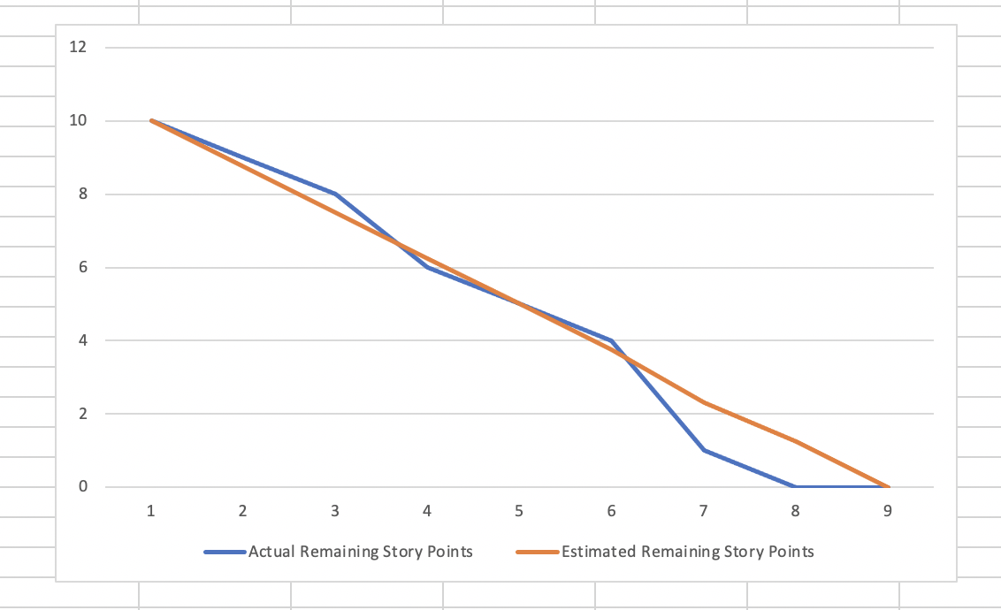
Sprint 4 Burndown
October 28, 2020 - November 16, 2020
We used Excel sheet to express our burndown chart.
This chart is based on Story Points.
We completed 2 user stories ONCC-19 and ONCC-20 in Sprint-4.
Committed Story Points=10
Completed Story Points=10
Completed Artifacts=100%
Velocity = 10

Slide 30
CS-692 Sprint 5-7 Recap

Slide 31
Sprint 5 Artifacts
Issue Type | ID | Summary | Priority | Status | Story Points
Story | ONCC-26e | As an Existing User, I want a record of saved code so that, I can retrieve my saved code whenever required | High | Done | 8
Task | ONCC-27e | Aggregation of the Tables for sharing code | High | Done | N/A
Task | ONCC-29e | Integration of DynamoDB + AWS | High | Done | N/A
Task | ONCC-28e | REST - API PUT, UPDATE, DELETE command | Medium | Done | N/A
Sprint 5 Goal:
Create Table for Save Module
Integrate DynamoDB with AWS Cloud Platform

Slide 32
Sprint 5 Test Cases
Test Cases for | ID | Steps | Test Scenario | Test Data | Expected Results | Actual Results | Pass/Fail
Save | ONCC-26e | 1 | Saving Code in Database | Code Written in the Code Area and clicking the save button | Code must be saved in the database | Code is getting stored in the database | PASS
 |  | 2 | Saving Code in Database | Empty code is stored | It should pop up the message that code is empty | When clicked on the save with empty code it shows that code is empty | PASS

Slide 33
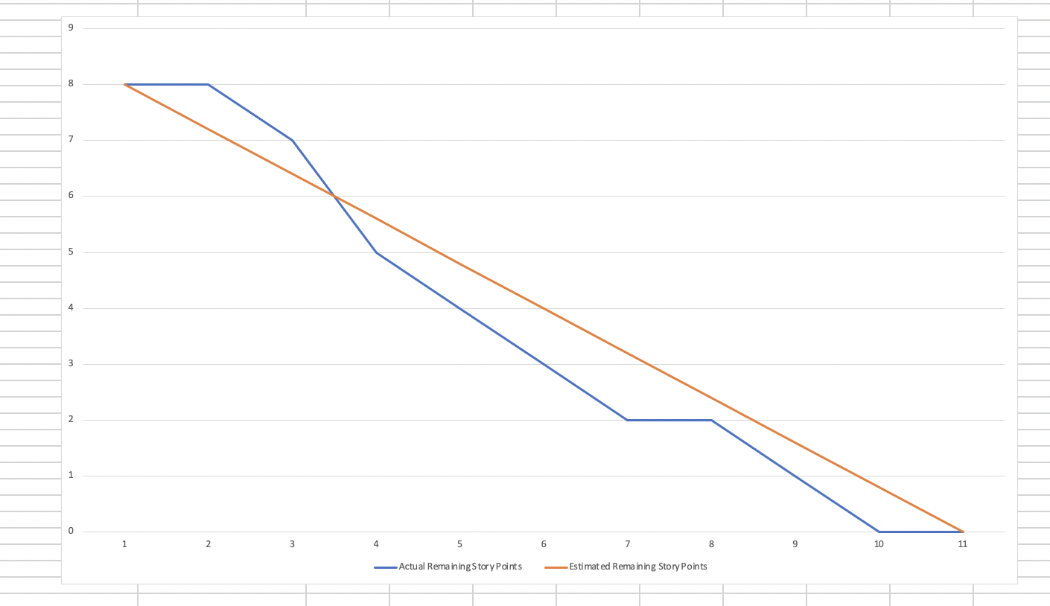
Sprint 5 Burndown
January 26, 2021 - February 23, 2021
We used Excel sheet to express our burndown chart.
This chart is based on Story Points.
We completed 1 user story ONCC-26e in Sprint-5
Committed Story Points=8
Completed Story Points=8
Completed Artifacts=100%
Velocity = 8

Slide 34
Sprint 6 Artifacts
Issue Type | ID | Summary | Priority | Status | Story Points (Estimated) | Story Points (Completed)
Story | ONCC-26 | As a guest user I want to access a web application on cloud server so that I can compile code in any programming languages | Highest | Done | 4 | 4
Story | ONCC-36 | As a guest user I want to have C programming language option so that I can compile my code in C language | Highest | Moved to Sprint 7 | 22 | 17
Task | ONCC-24 | Get reference of C compiler using python pre-processing module | Highest | Done | N/A | N/A
Task | ONCC-21 | Migration of MongoDB user table to DynamoDB part2 | Highest | Done | N/A | N/A
Task | ONCC-20 | Onboarded whole team on AWS | Highest | Done | N/A | N/A
Task | ONCC-48 | Merging C module with flask web application | Medium | Moved to 7 | N/A | N/A
Bug | ONCC-49 | Connectivity between C module and web application | Medium | Moved to 7 | N/A | N/A
Task | ONCC-25 | Make a module to take pre-defined input from user | Medium | Done | N/A | N/A
Task | ONCC-23 | Installation of C module on system | Medium | Done | N/A | N/A
Task | ONCC-29 | Create sprint 6 presentation slides | Medium | Done | N/A | N/A
Task | ONCC-28 | Update website design to make user friendly | Low | Moved to 7 | N/A | N/A
Task | ONCC-31 | Update user manual sprint 6 | Low | Done | N/A | N/A
Task | ONCC-30 | Update technical paper sprint 6 | Low | Done | N/A | N/A
Task | ONCC-35 | Update wiki page sprint 6 | Low | Done | N/A | N/A
Sprint 6 Goal:
Onboarding of whole team on AWS
Felicitate Compiler with C module
Migration of MongoDB tables to DynamoDB

Slide 35
Sprint 6 Test Cases
Test Cases for | Key | Steps | Test Cases | Test Data | Expected Results | Actual Results | Status
Cloud access | ONCC-26 | 1 | Options available for C compiler in drop-down menu | Selecting C option from drop-down menu | C compiler will be selected and “Write code in C language here” placeholder will be displayed in the text area | C compiler is selected and “Write code in C language here” placeholder is displayed in the text area | PASS
Compiler | ONCC-36 | 1 | Writing and compiling the code in C language. | Enters the code in C language and click on Run button | Code should be compiled successfully and get the desired output or errors | No output or error message displayed | FAIL
 |  |  |  |  | Code is not successfully compiled and shows error | No output or error message displayed | FAIL
 |  | 2 | Compiling empty code | Click on Run button without writing code | Will show error for empty code in error field | No error message displayed | FAIL
 |  | 3 | Running test code in python pre-processing module | Entering C code in pre-processing module | Getting desired output in String variable | Got output in the String variable | PASS
 |  |  |  |  | Getting expected error in Error variable if code is wrong | Got desired error in the Error variable | PASS
 |  |  |  |  | Entering Predefined Input for the code to compile with input | Accepting input for written code and compiling with the input | PASS
 |  | 4 | Entering Predefined input | Entering input in the input field for the compilation of code with input parameter | Taking input from input field and adding it into the code | No output | FAIL
 |  |  |  |  | Showing input missing when the field is empty when required | No Output | FAIL

Slide 36
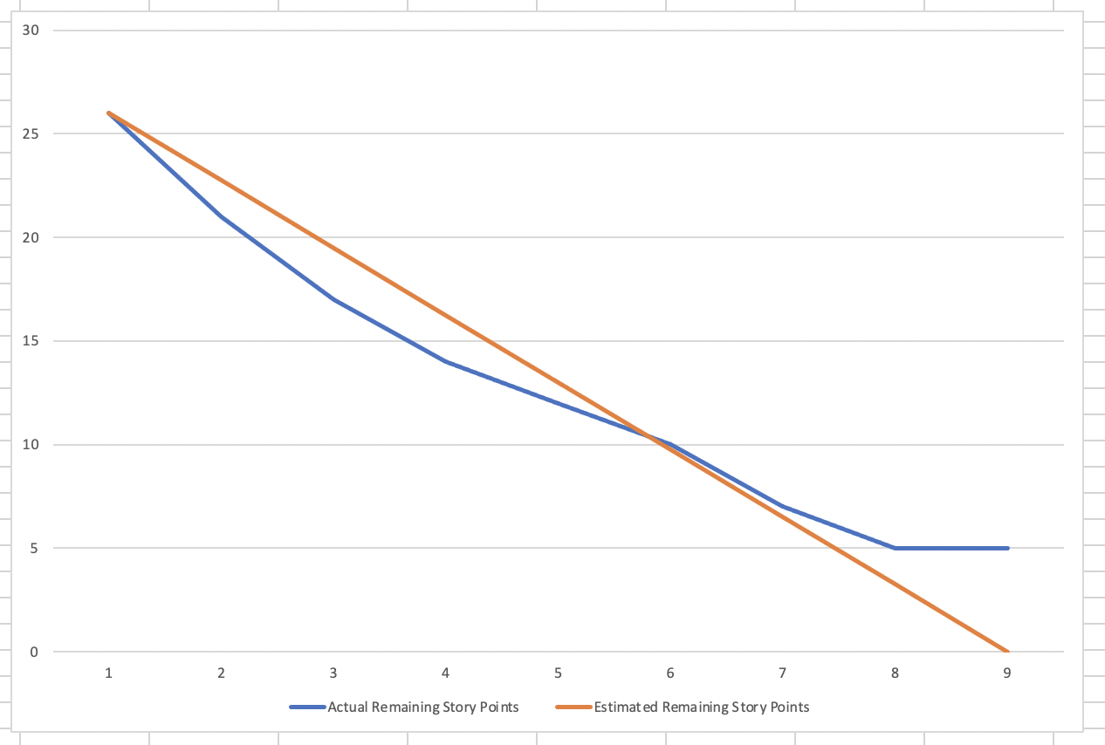
Sprint 6 Burndown
February 24, 2021 - March 16, 2021
We used Excel sheet to express our burndown chart.
This chart is based on Story Points.
We completed 1 user story ONCC-26 in Sprint-6
Committed Story Points=26
Completed Story Points=21
Completed Artifacts= 80%
Velocity = 21

Slide 37
Sprint 7 Artifacts
Issue Type | ID | Summary | Priority | Status | Expected Story Points | Total Story Points (Completed)
Story | ONCC-19 | As a Guest User, I want to have an option to select Java programming language so that I can compile my code written in Java language | High | Done | 8 | 8
Story | ONCC-20e | As a Registered User, I want to have a login page so that I can use features like save and edit existing code which are exclusively available for registered users only | High | Done | 2 | 2
Task | ONCC-21e | Decoding the password while comparing the password | High | Done | 0 | 0
Task | ONCC-22e | Initiate the saving source code module in front-end | High | Done | 0 | 0
Task | ONCC-23e | Create table for saving source code | High | Done | 0 | 0
Task | ONCC-24e | Aggregation of the tables for saving source code to specific user | High | Done | 0 | 0
Task | ONCC-26e | Create session for each user after login | High | Done | 0 | 0
Task | ONCC-18e | Existing user can not re-register | Medium | Done | 0 | 0
Task | ONCC-25e | REST-API Put, Update, Delete Command | Medium | Done | 0 | 0
Issue Type | ID | Summary | Priority | Status | Story Points
Story | ONCC-26 | As a guest user I want to access a web application on cloud server so that I can compile code in any programming languages | Highest | Done | 4
Story | ONCC-36 | As a guest user I want to have C programming language option so that I can compile my code in C language | Highest | Moved to Sprint 7 | 22
Task | ONCC-24 | Get reference of C compiler using python pre-processing module | Highest | Done | N/A
Task | ONCC-21 | Migration of MongoDB user table to DynamoDB part2 | Highest | Done | N/A
Task | ONCC-20 | Onboarded whole team on AWS | Highest | Done | N/A
Task | ONCC-48 | Merging C module with flask web application | Medium | Moved to 7 | N/A
Bug | ONCC-49 | Connectivity between C module and web application | Medium | Moved to 7 | N/A
Task | ONCC-25 | Make a module to take pre-defined input from user | Medium | Done | N/A
Task | ONCC-23 | Installation of C module on system | Medium | Done | N/A
Task | ONCC-29 | Create sprint 6 presentation slides | Medium | Done | N/A
Task | ONCC-28 | Update website design to make user friendly | Low | Moved to 7 | N/A
Task | ONCC-31 | Update user manual sprint 6 | Low | Done | N/A
Task | ONCC-30 | Update technical paper sprint 6 | Low | Done | N/A
Task | ONCC-35 | Update wiki page sprint 6 | Low | Done | N/A
Issue Type | ID | Summary | Priority | Status | Story Points
Story | ONCC-36 | As a Guest User, I want to have an option to select C programming language so that I can compile my code written in C language | Highest | Done | 22
Task | ONCC-43 | Embedding compiler into the web Application | Highest | Done | N/A
Story | ONCC-51 | As a Guest User, I want to have an option to select C++ programming language so that I can compile my code written in C++ language | Highest | Done | 22
Story | ONCC-37 | As an Existing User, I want the ability to Save my code so that I can retrieve my saved code whenever required | High | Done | 6
Task | ONCC-38 | Create a table for saving code | High | Done | N/A
Task | ONCC-53 | Get the reference of the C++ compiler using python pre-processing module | Medium | Done | N/A
Task | ONCC-63 | Make a module to take pre-defined input from user for C++ module | Medium | Done | N/A
Task | ONCC-54 | Merge C++ language compiler module with Flask web application | Medium | Done | N/A
Task | ONCC-52 | Installation of C++ compiler module on system | Medium | Done | N/A
Task | ONCC-48 | Merge C language compiler module with Flask web application | Medium | Done | N/A
Task | ONCC-46 | Update User Manual | Medium | Done | N/A
Bug | ONCC-61 | Layout of the HTML page is disrupted after embedding compiler module in flask web application | Medium | Done | N/A
Task | ONCC-55 | Update Wiki page on GitHub | Medium | Done | N/A
Task | ONCC-44 | Make presentation slides for sprint7 | Medium | Done | N/A
Task | ONCC-40 | Fetch saved code from database | Medium | Done | N/A
Task | ONCC-45 | Update technical Paper | Medium | Done | N/A
Task | ONCC-28 | Update website design and make it more user friendly | Low | Done | N/A
Task | ONCC-39 | Update front-end for save feature | Low | Done | N/A
Sprint 7 Goal
Compiler has facilitated with C and C++ language module.
Save Feature is available for authorized users to save their code whenever required for future use.

Slide 38
Sprint 7 Test Cases
Test Cases for | Story ID | Steps | Test Cases | Test Data | Expected Results | Actual Results | Status
Compiler | ONCC 36 | 1 | Writing and compiling the code in C language. | Enters the code in C language and click on Run button | Code should be compiled successfully and get the desired output or errors | Code should be compiled successfully and get the desired output or errors | PASS
 |  |  |  | Enters the code in C language and click on Run button | Code is not successfully compiled and shows error | Code Returns Appropriate Error in the error list | PASS
 |  | 2 | Compiling empty code | Click on Run button without writing code | Will show error for empty code in error field | Shows Empty Code message | PASS
 |  | 3 | Running test code in python pre-processing module | Entering C code in pre-processing module | Getting desired output in String variable | Got output in the String variable | PASS
 |  |  |  | Entering C code in pre-processing module | Getting expected error in Error variable if code is wrong | Got desired error in the Error variable | PASS
 |  |  |  | Entering C code in pre-processing module | Entering Predefined Input for the code to compile with input | Accepting input for written code and compiling with the input | PASS
 |  | 4 | Entering Predefined input | Entering input in the input field for the compilation of code with input parameter | Taking input from input field and adding it into the code | Predefined Input was taken from the code | PASS
 |  |  |  | Entering input in the input field for the compilation of code with input parameter | Showing input missing when the field is empty when required | No Output | FAIL
Save | ONCC-37 | 1 | Saving Code in Database | Code Written in the Code Area and clicking the save button | Code must be saved in the database and should display the title in the saved area | Code is getting stored in the database and it is displayed in the saved area | PASS
 |  | 2 | Saving Code in Database | Empty code is stored | It should pop up the message that code is empty | When clicked on the save with empty code it shows that code is empty | FAIL

Slide 39
Sprint 7 Test Cases Continued
Test Cases for | Story ID | Steps | Test Cases | Test Data | Expected Results | Actual Results | Status
Compiler | ONCC-51 | 1 | Writing and compiling the code in C++ language. | Enters the code in C++ language and click on Run button | Code should be compiled successfully and get the desired output or errors | Code should be compiled successfully and get the desired output or errors | PASS
 |  |  |  | Enters the code in C++ language and click on Run button | Code is not successfully compiled and shows error | Code Returns Appropriate Error in the error list | PASS
 |  | 2 | Compiling empty code | Click on Run button without writing code | Will show error for empty code in error field | Shows Empty Code message | PASS
 |  | 3 | Running test code in python pre-processing module | Entering C++ code in pre-processing module | Getting desired output in String variable | Got output in the String variable | PASS
 |  |  |  | Entering C++ code in pre-processing module | Getting expected error in Error variable if code is wrong | Got desired error in the Error variable | PASS
 |  |  |  | Entering C++ code in pre-processing module | Entering Predefined Input for the code to compile with input | Accepting input for written code and compiling with the input | PASS
 |  | 4 | Entering Predefined input | Entering input in the input field for the compilation of code with input parameter | Taking input from input field and adding it into the code | Predefined Input was taken from the code | PASS
 |  |  |  | Entering input in the input field for the compilation of code with input parameter | Showing input missing when the field is empty when required | No Output | FAIL

Slide 40
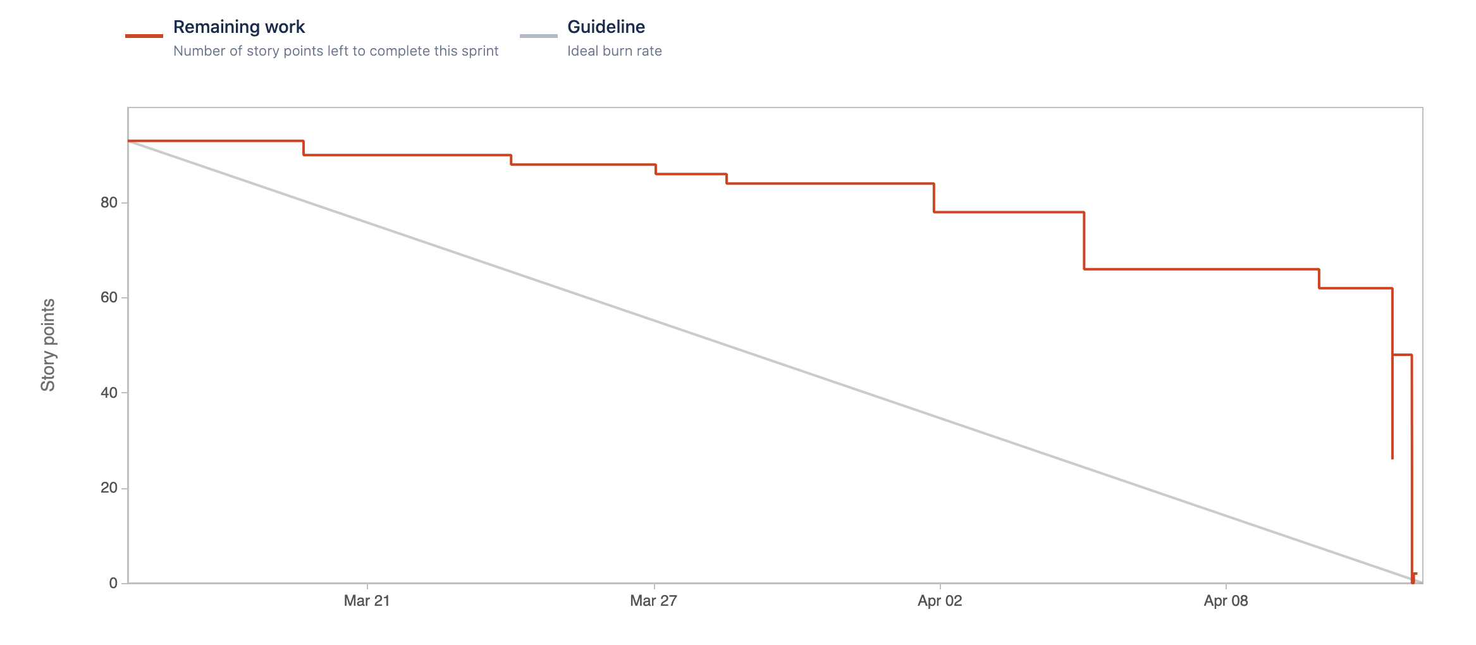
Sprint 7 Burndown
March 17, 2021 - April 14, 2021
This chart is based on Story Points.
We completed 3 user stories ONCC-36, ONCC-51 and ONCC-37 in Sprint-7.
Committed Story Points=50
Completed Story Points=50
Completed Artifacts=100%
Velocity = 50
Note :- In this sprint, we have considered story points for tasks also. Based on feedback, we have removed story points of tasks from sprint artifacts.

Slide 41
CS-692 Sprint 8

Slide 42

Overview of Sprint 8
An online cloud compiler web application with five most demanding programming languages such as C/C++, Java, Python and C#.
In this sprint, we resolved a bug for Layout of the page disruption which was causing after embedding compiler module.
The compiler has facilitated with C/C++, Java, Python and C# language module in the drop-down menu.
Our new feature is available for guest users to create new file.
We have made our website more user-friendly to access.
Our website is hosted on the AWS cloud platform.

Slide 43
Recap of Sprint 7
Issue Type | ID | Summary | Priority | Status | Story Points
Story | ONCC-36 | As a Guest User, I want to have an option to select C programming language so that I can compile my code written in C language | Highest | Done | 22
Task | ONCC-43 | Embedding compiler into the web Application | Highest | Done | N/A
Story | ONCC-51 | As a Guest User, I want to have an option to select C++ programming language so that I can compile my code written in C++ language | Highest | Done | 22
Story | ONCC-37 | As an Existing User, I want the ability to Save my code so that I can retrieve my saved code whenever required | High | Done | 6
Task | ONCC-38 | Create a table for saving code | High | Done | N/A
Task | ONCC-53 | Get the reference of the C++ compiler using python pre-processing module | Medium | Done | N/A
Task | ONCC-63 | Make a module to take pre-defined input from user for C++ module | Medium | Done | N/A
Task | ONCC-54 | Merge C++ language compiler module with Flask web application | Medium | Done | N/A
Task | ONCC-52 | Installation of C++ compiler module on system | Medium | Done | N/A
Task | ONCC-48 | Merge C language compiler module with Flask web application | Medium | Done | N/A
Task | ONCC-46 | Update User Manual | Medium | Done | N/A
Bug | ONCC-61 | Layout of the HTML page is disrupted after embedding compiler module in flask web application | Medium | Done | N/A
Task | ONCC-55 | Update Wiki page on GitHub | Medium | Done | N/A
Task | ONCC-44 | Make presentation slides for sprint7 | Medium | Done | N/A
Task | ONCC-40 | Fetch saved code from database | Medium | Done | N/A
Task | ONCC-45 | Update technical Paper | Medium | Done | N/A
Task | ONCC-28 | Update website design and make it more user friendly | Low | Done | N/A
Task | ONCC-39 | Update front-end for save feature | Low | Done | N/A

Slide 44
Sprint 8 Report
Issue Type | ID | Summary | Priority | Status | Story Points
Story | ONCC-56 | As a Guest User, I want to have an option to select C# programming language so that I can compile my code written in C# language | Highest | Done | 8
Task | ONCC-69 | Make Presentation slides for final Sprint | High | Done | N/A
Task | ONCC-68 | Update GitHub Wiki Page for all Final Sprint | High | Done | N/A
Story | ONCC-65 | As a New/Existing User, I want to access my compiler on web so that I don’t have to download all IDEs on the local machine | High | Done | 2
Story | ONCC-64 | As a New/Existing User I want the website to be more user-friendly so that I can easily access the compiler | High | Done | 2
Task | ONCC-67 | Update technical paper for final sprint | Medium | Done | N/A
Task | ONCC-66 | Reorganize all the previous sprint documents | Medium | Done | N/A
Bug | ONCC-61 | Layout of the HTML page is disrupted after embedding compiler module in flask web application | Medium | Done | N/A
Task | ONCC-60 | Merging the C# language compiler module with Flask web application | Medium | Done | N/A
Task | ONCC-59 | Make a module to take pre-defined input from user for C# language | Medium | Done | N/A
Task | ONCC-58 | Get the reference of the C# compiler using python pre-processing module | Medium | Done | N/A
Task | ONCC-57 | Installation of C# compiler module on system | Medium | Done | N/A
Task | ONCC-50 | Implementing AWS services i.e., Boto3, AWS authy in Compiler | Medium | Done | N/A
Task | ONCC-42 | Create a LogDB to store logged in user sessions | Medium | Done | N/A
Story | ONCC-41 | As a New/Existing User, I want to have an ability to select New option so that I can create New program | Medium | Done | 1
Task | ONCC-47 | Plan how to prioritize the severity level of the issues, feedback or task. | Low | Done | N/A

Slide 45
Committed and Completed Artifacts
ID | User Story | Acceptance Criteria | Story Priority | Story Points
ONCC-56 | As a Guest User, I want to have an option to select C# programming language so that I can compile my code written in C# language | Given that the Guest User is on the Home Page, when the user select the option for C# programming language from drop-down menu, then the user will be able to write and compile code in C# language. | Highest | 8
ONCC-65 | As a New/Existing User, I want to access my compiler on web so that I don’t have to download all IDEs on the local machine | Given that the New/Existing User wants to write programs in multiple languages and get the desired output without having downloaded multiple IDEs then the user can access the online compiler over the website. | High | 2
ONCC-64 | As a New/Existing User, I want the website to be more user-friendly so that I can easily access the compiler | Given that the New/Existing User wants to easily access the website then the User can use it properly by having it at their fingertips. | High | 2
ONCC-41 | As a New/Existing User, I want to have an ability to select New option so that I can create New program | Given that the New/Existing User is on the Home Page, the user will be able to create New Program after clicking on “New” button. | Medium | 1

Slide 46
Sprint 8 Test Cases
Test Cases for | Story ID | Steps | Test Cases | Test Data | Expected Results | Actual Results | Status
Compiler | ONCC 56 | 1 | Writing and compiling the code in C# language. | Enters the code in C# language and click on Run button | Code should be compiled successfully and get the desired output or errors | Code should be compiled successfully and get the desired output or errors | PASS
 |  |  |  | Enters the code in C# language and click on Run button | Code is not successfully compiled and shows error | Code Returns Appropriate Error in the error list | PASS
 |  | 2 | Compiling empty code | Click on Run button without writing code | Will show error for empty code in error field | Shows Empty Code message | PASS
 |  | 3 | Running test code in python pre-processing module | Entering C# code in pre-processing module | Getting desired output in String variable | Got output in the String variable | PASS
 |  |  |  | Entering C# code in pre-processing module | Getting expected error in Error variable if code is wrong | Got desired error in the Error variable | PASS
 |  |  |  | Entering C# code in pre-processing module | Entering Predefined Input for the code to compile with input | Accepting input for written code and compiling with the input | PASS
 |  | 4 | Entering Predefined input | Entering input in the input field for the compilation of code with input parameter | Taking input from input field and adding it into the code | Predefined Input was taken from the code | PASS
 |  |  |  | Entering input in the input field for the compilation of code with input parameter | Showing input missing when the field is empty when required | Input missing message displays if input is not entered | PASS
Website | ONCC 64 | 1 | Accessability of the website feature is user friendly | Accesssing feature of wbapplication easily | All the features of Web application works smoothly without any hustle | There was no hustle behind working of features of the web application | PASS
 |  | 2 | Design of the website is attractive | requeting all the web paegs of web application for design check | Design of the webpage is consisitent in all web pages | Few web pages has no design consistency | FAIL
Cloud | ONCC 65 | 1 | Web Application Is accessble over the cloud | Web application should be available when tried to access over the website | Web application should appear when it is requested. | Web application is accessable when requested | PASS
 |  | 2 | All the featues of the web application should be working smoothly | requesting all the features of the web application one by one | All the features of Web application works as requested | All the features are working on the request | PASS

Slide 47
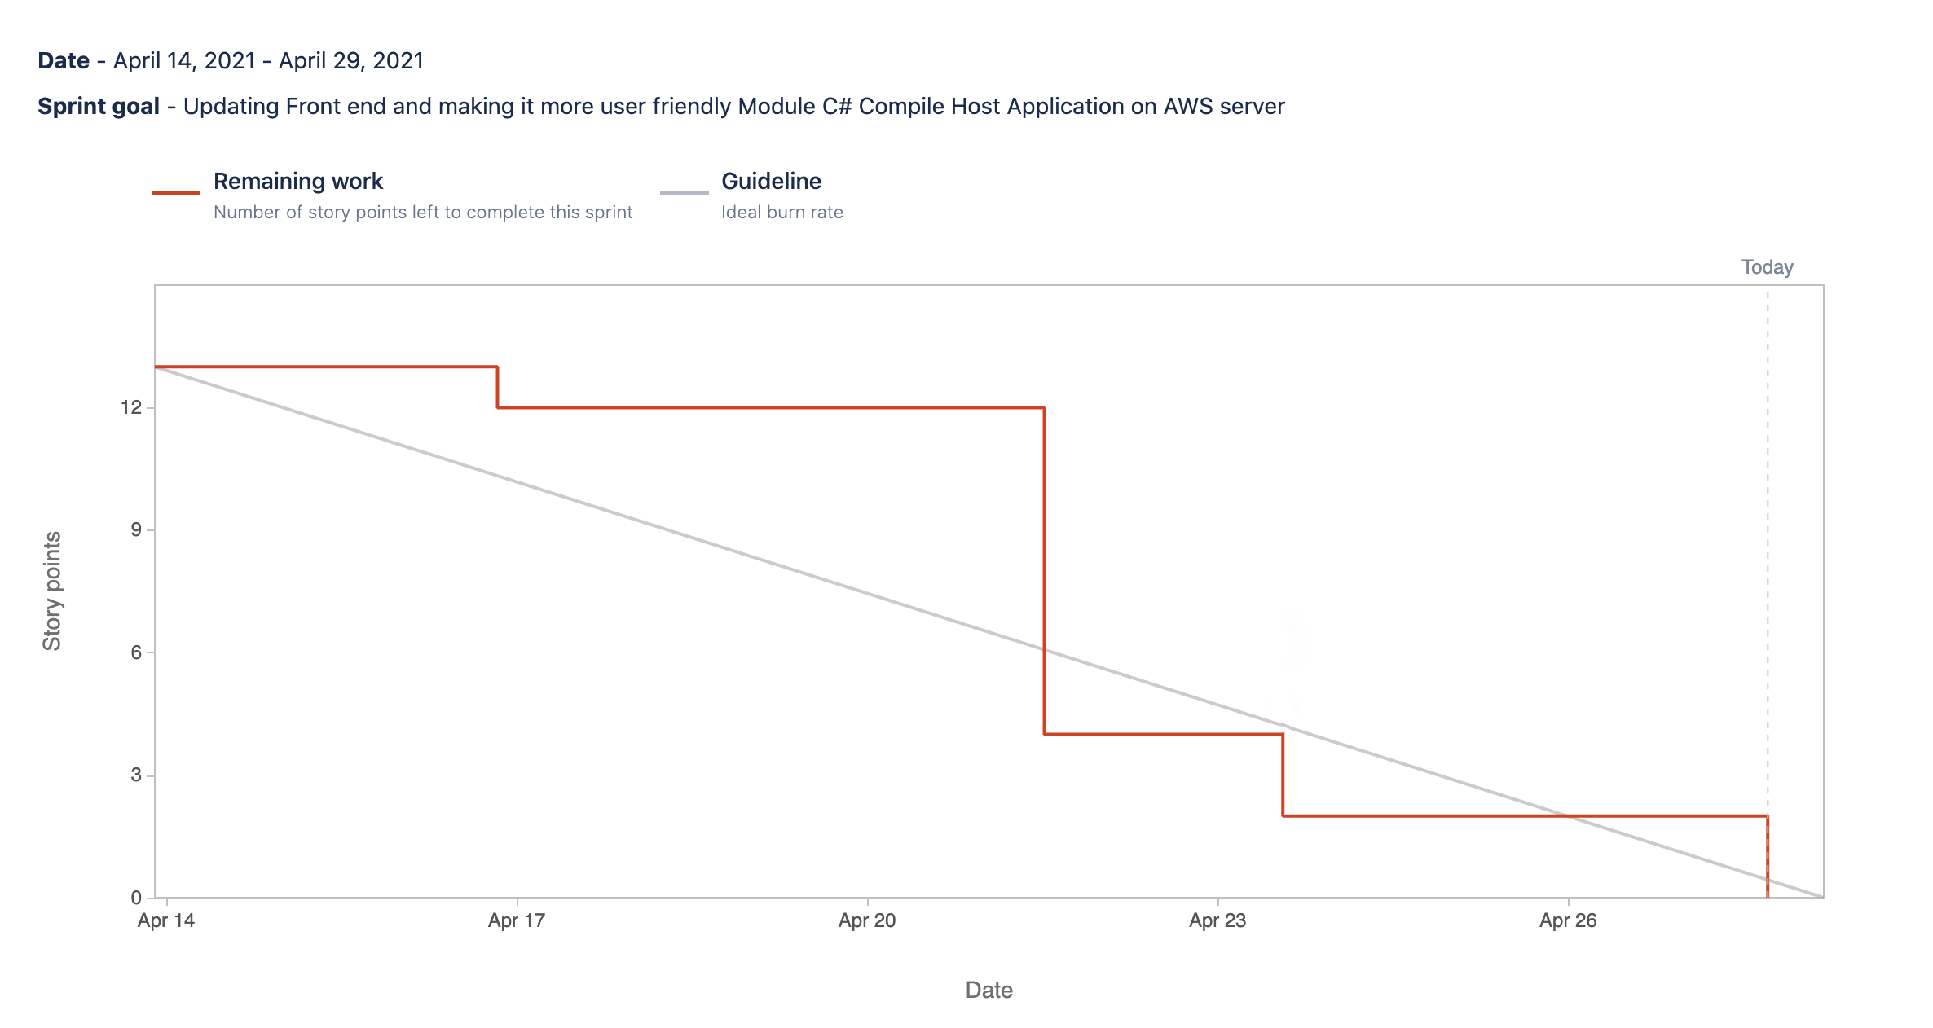
Sprint 8 Burndown
April 14, 2021 - April 29, 2021
This chart is based on Story Points.
We completed 3 user stories ONCC-36, ONCC-51 and ONCC-37 in Sprint-7.
Committed Story Points=13
Completed Story Points=13
Completed Artifacts=100%
Velocity = 13

Slide 48
Project Deliverables

Slide 49
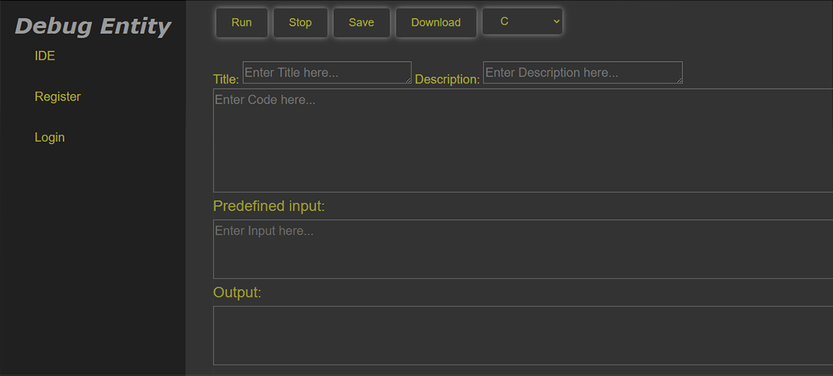
Homepage

Slide 50
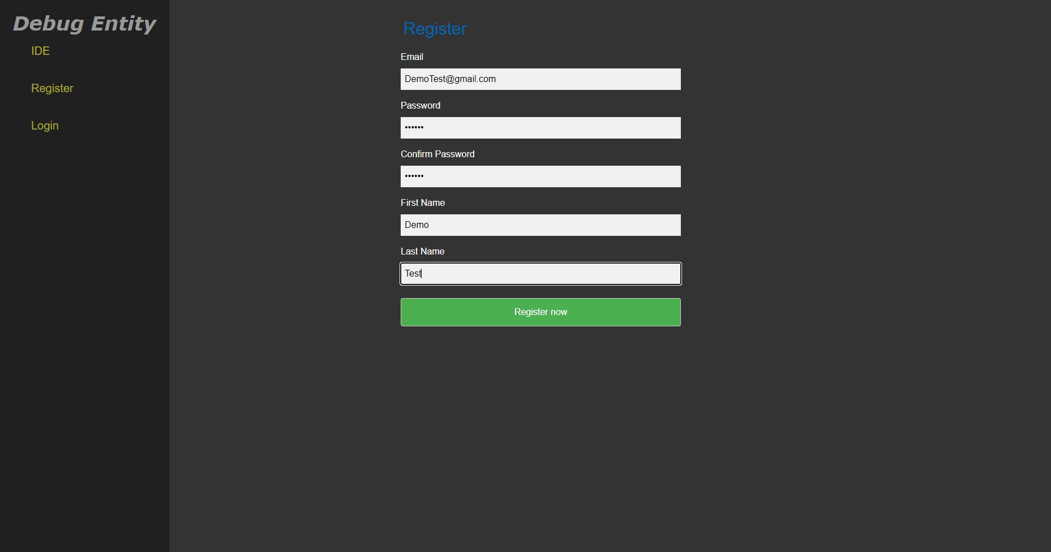
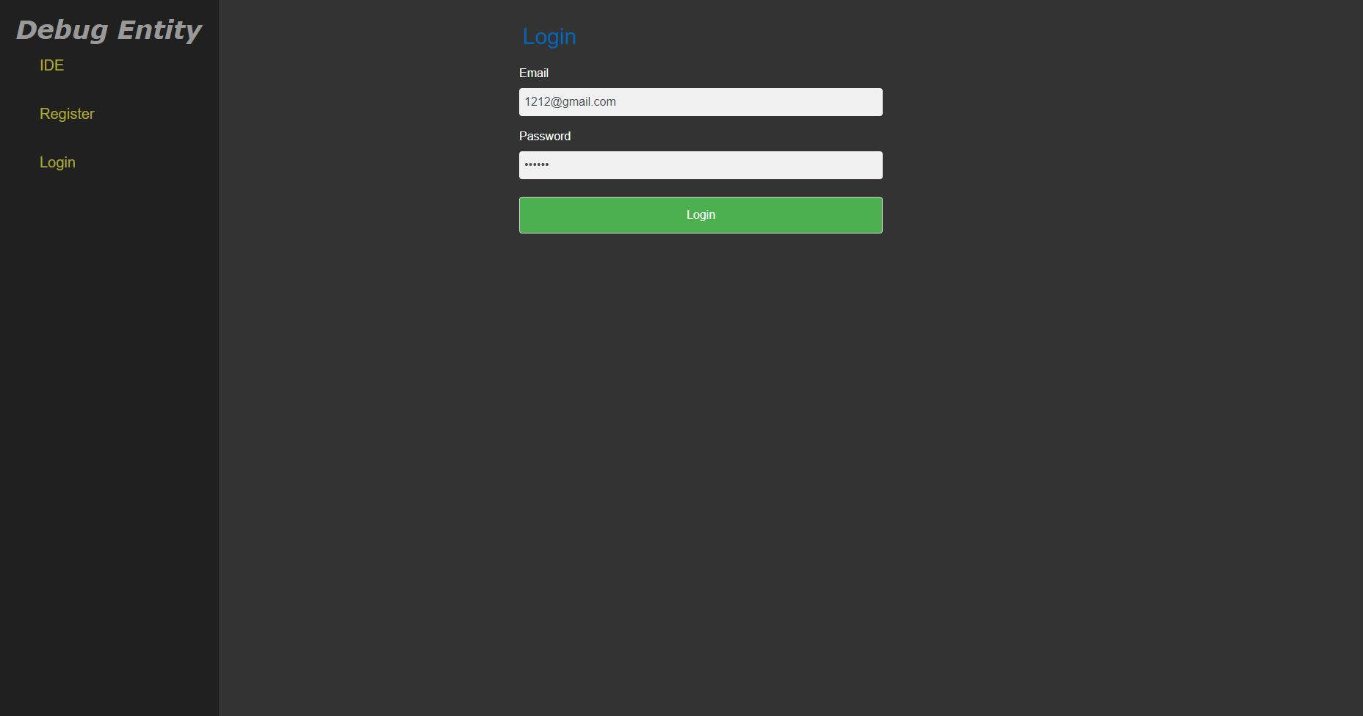
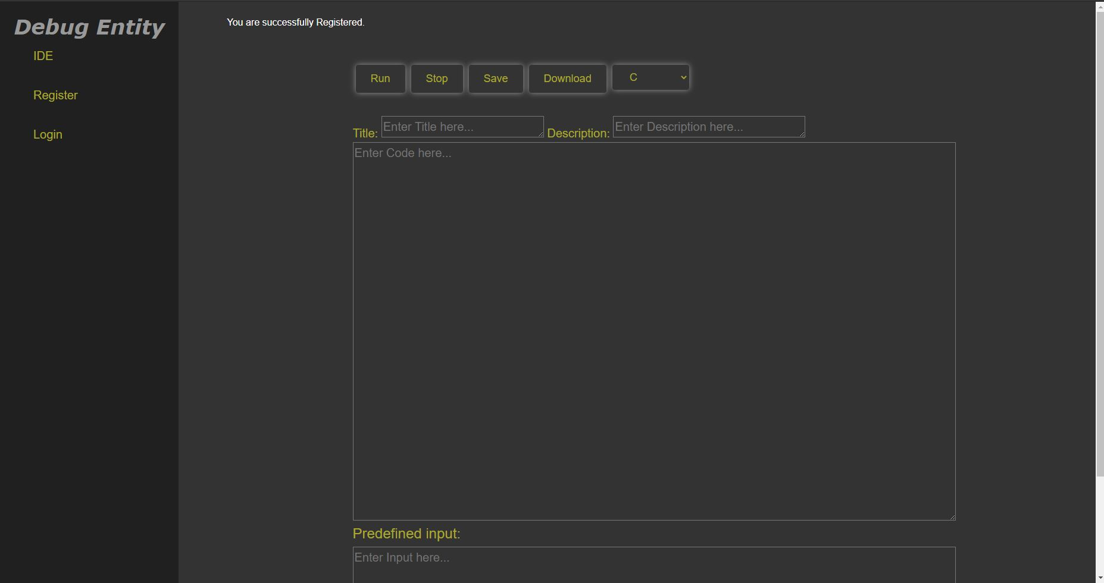
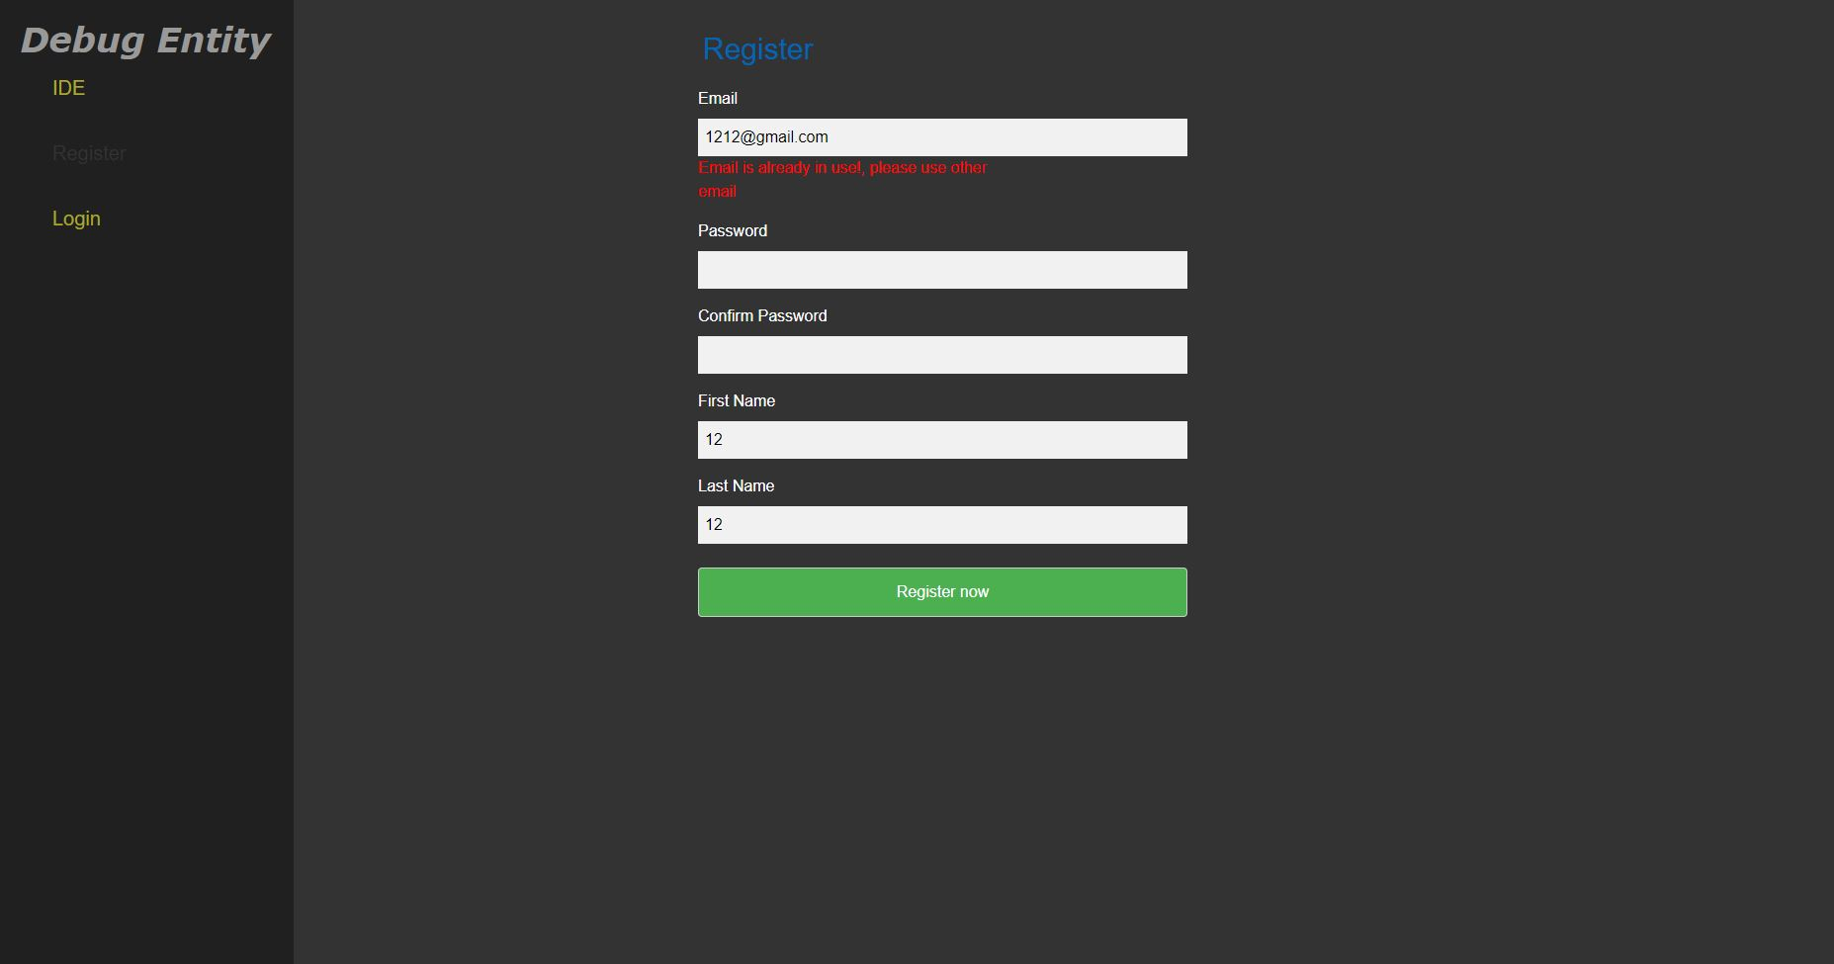
Registration

Slide 51
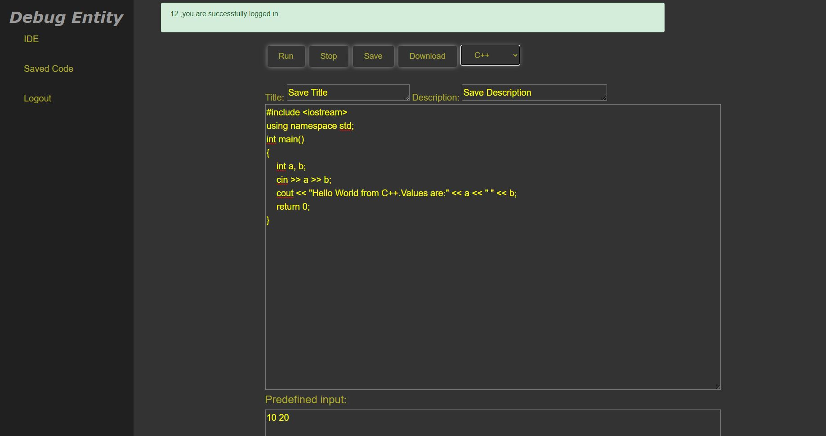
Login

Slide 52
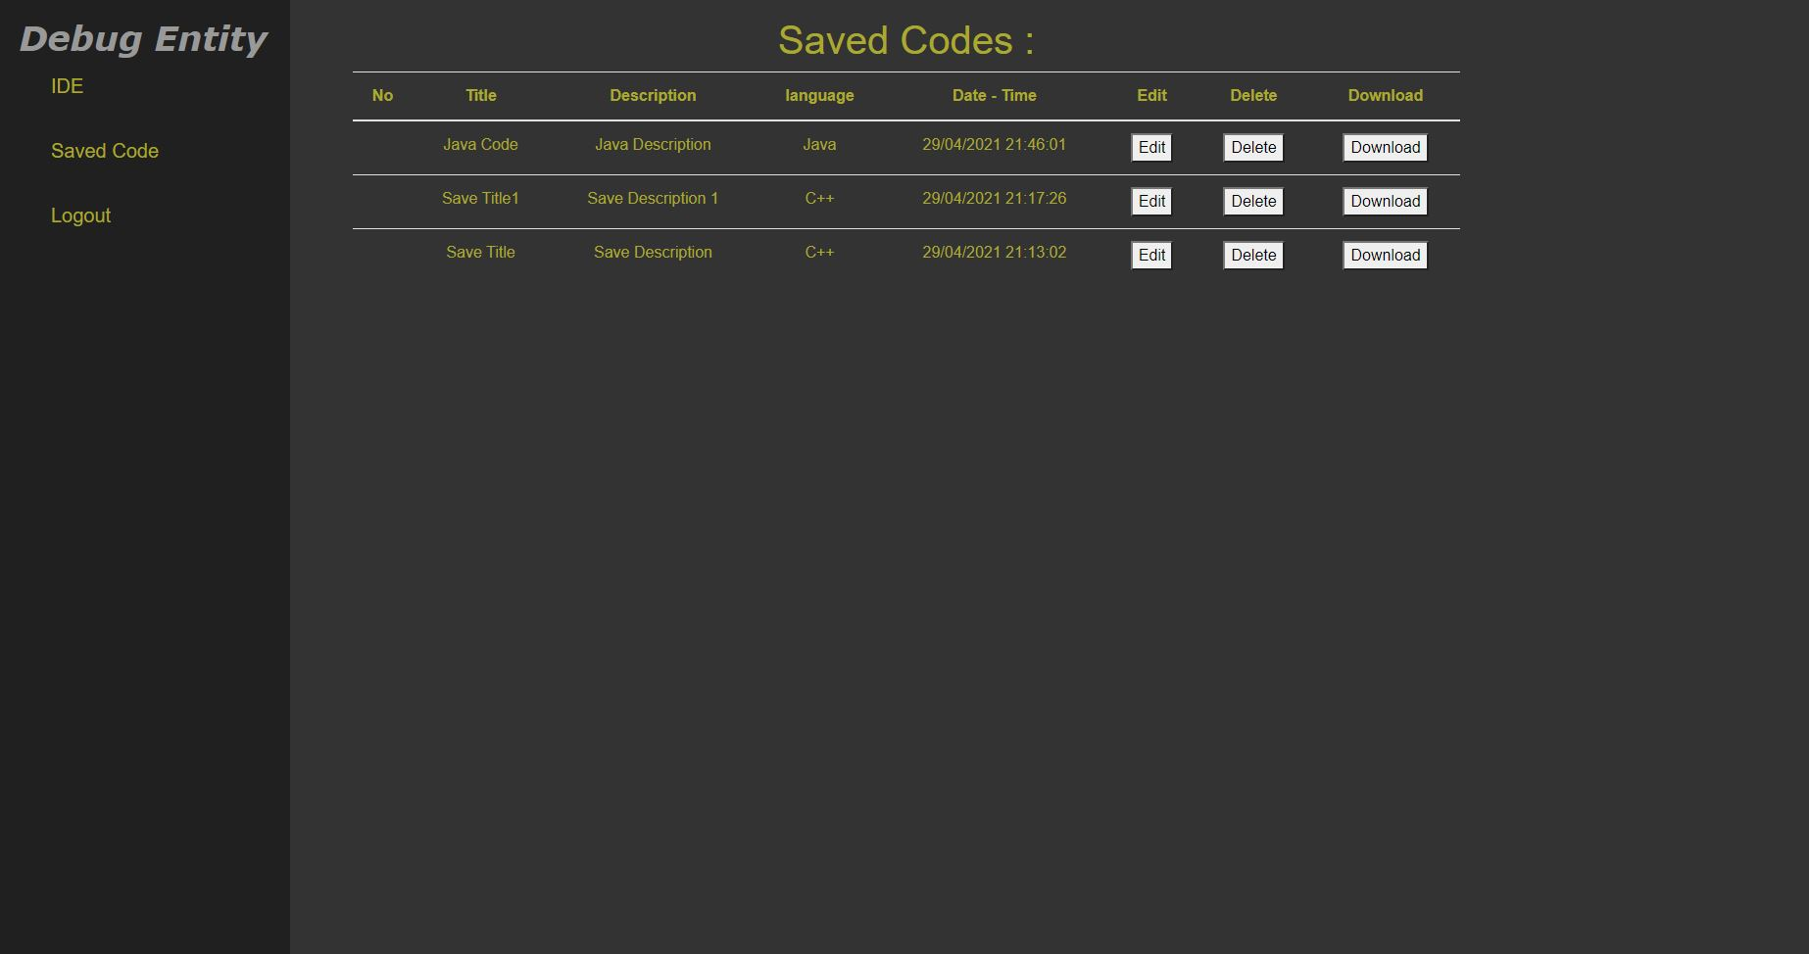
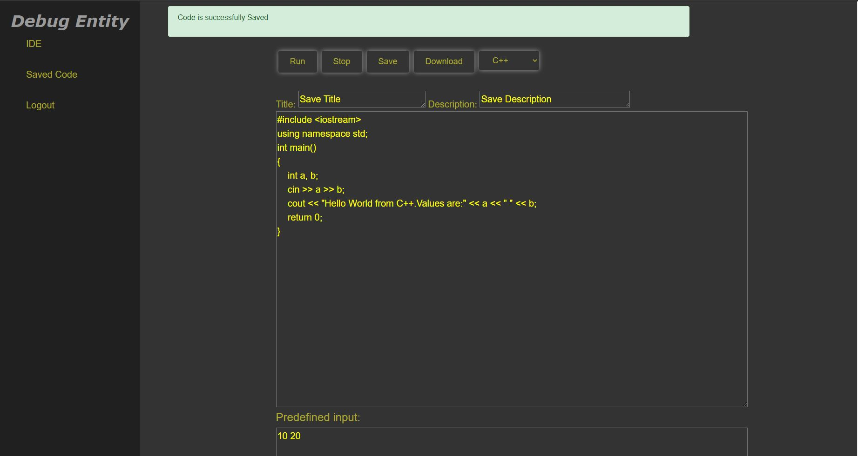
Save

Slide 53
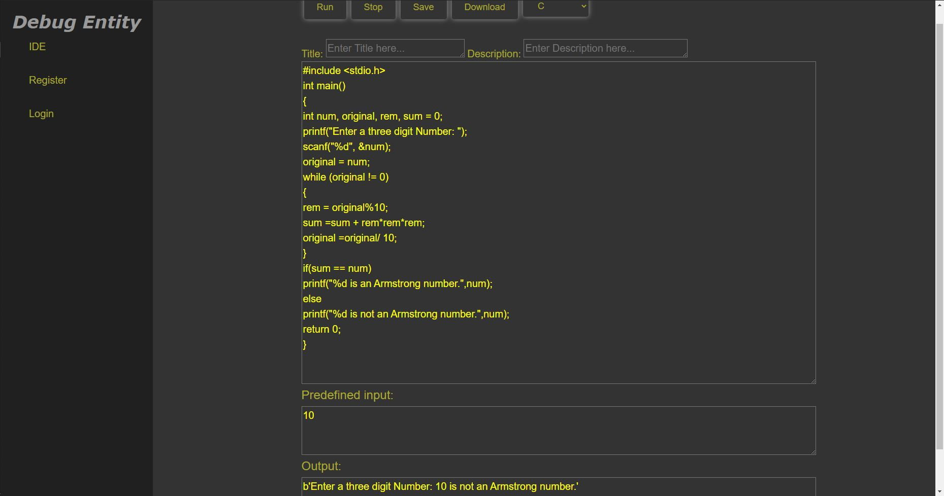
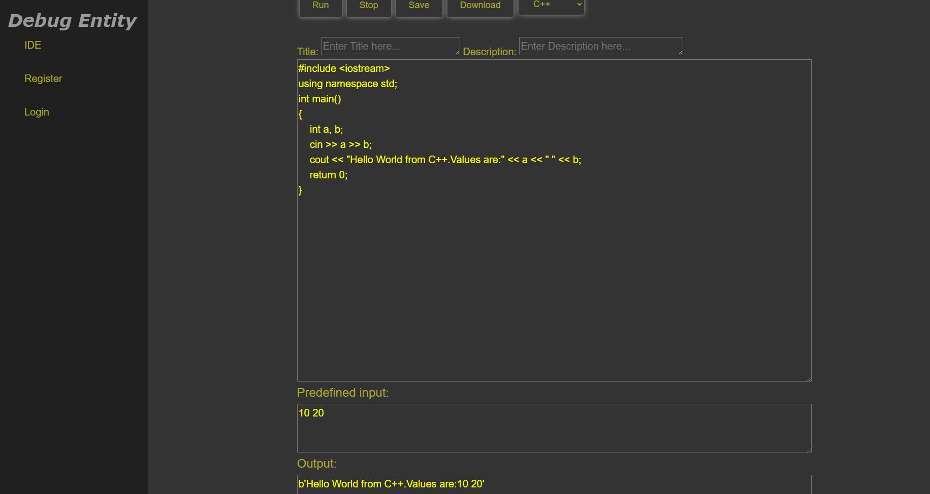
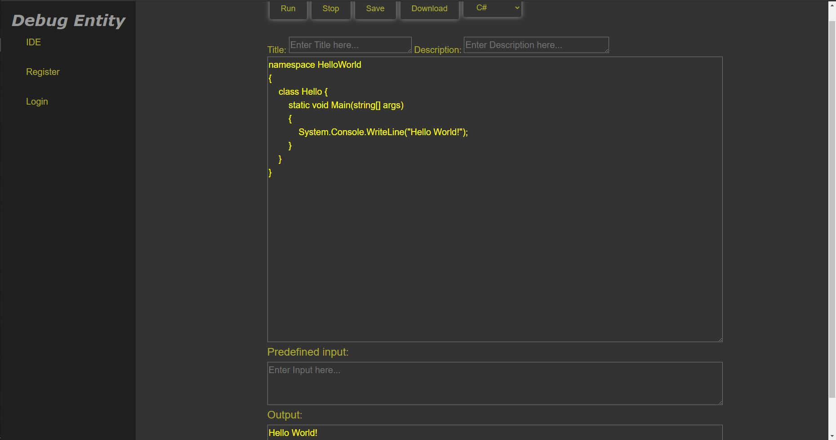
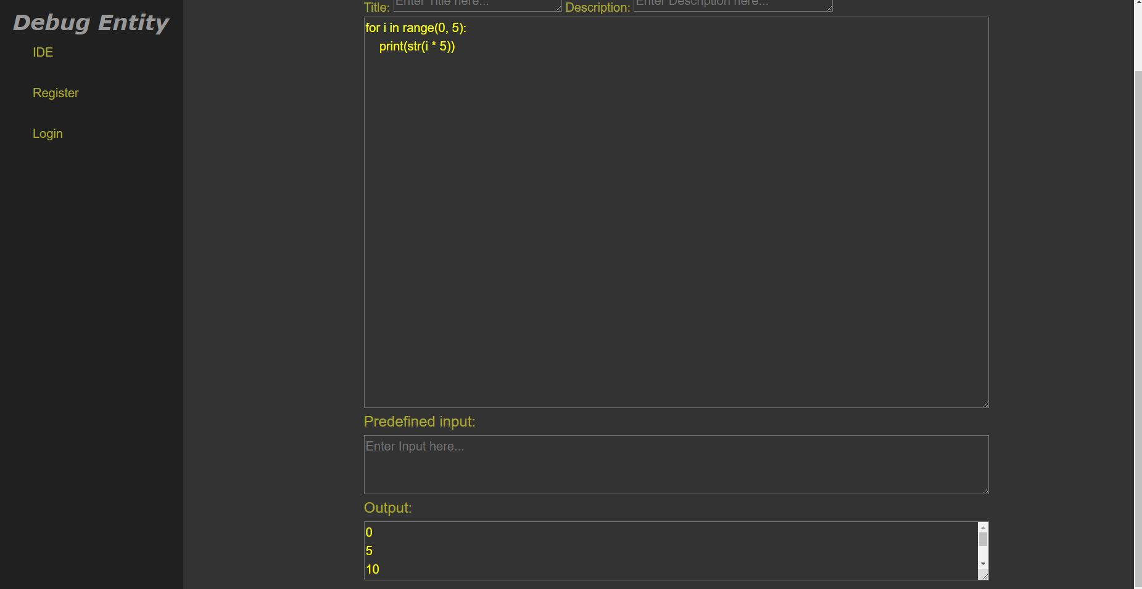
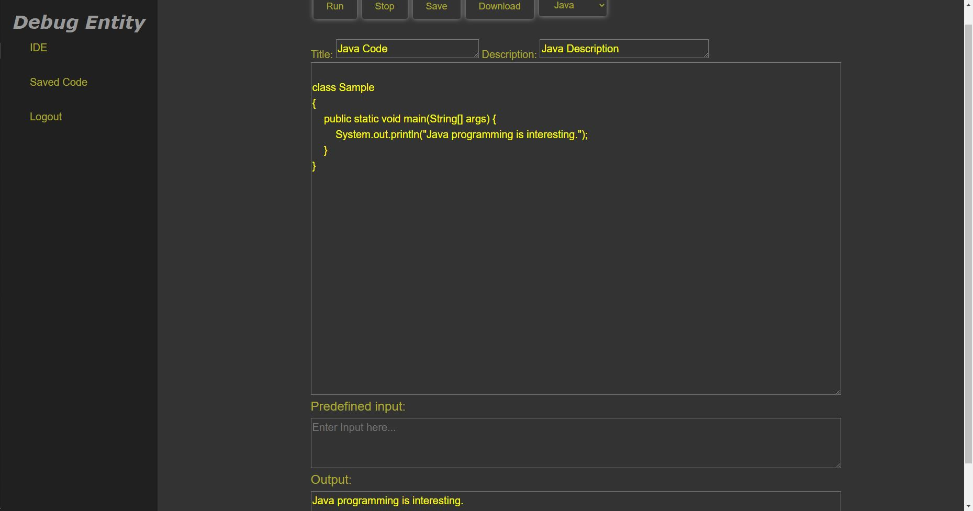
Compiler
C Compiler
C++ Compiler
C# Compiler
Python Compiler
Java Compiler

Slide 54
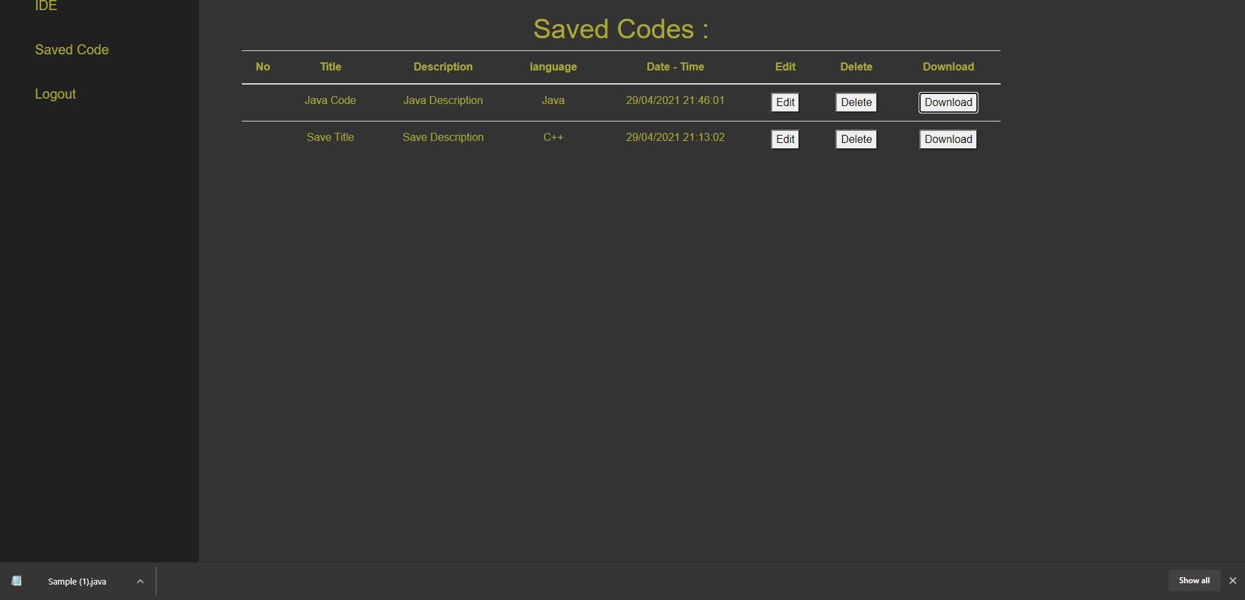
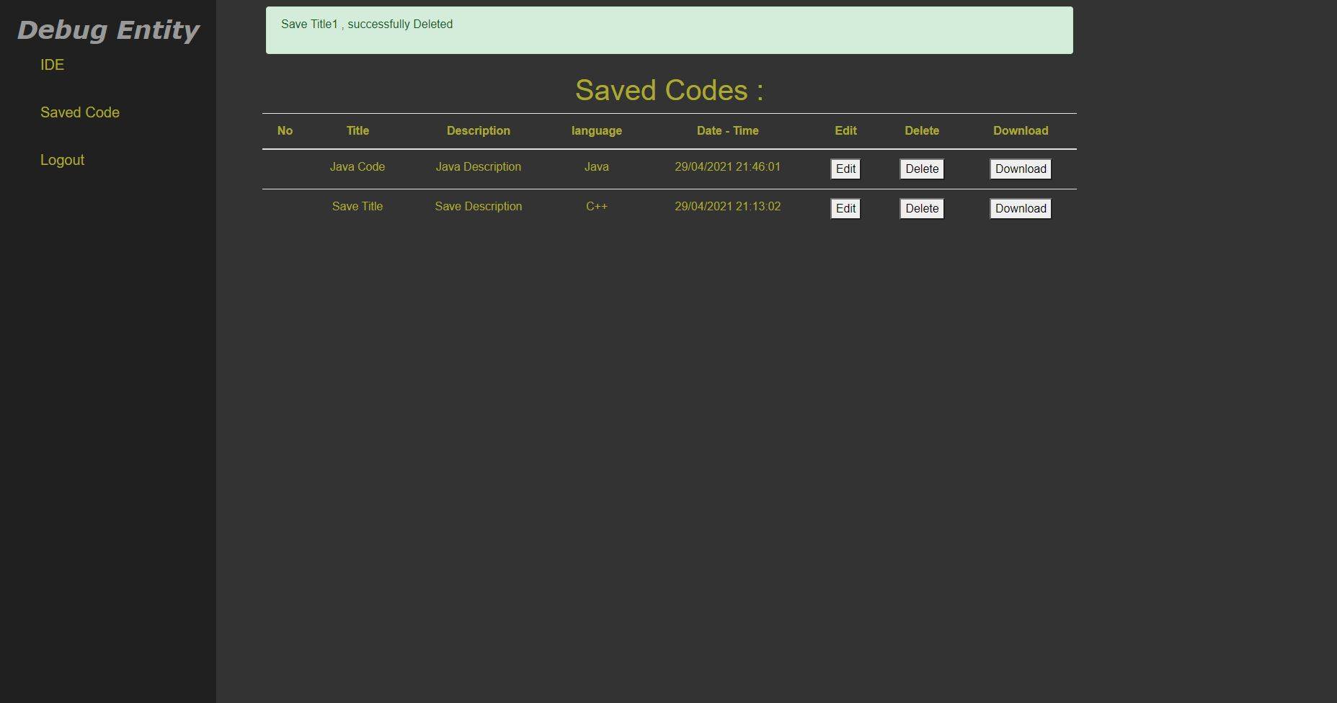
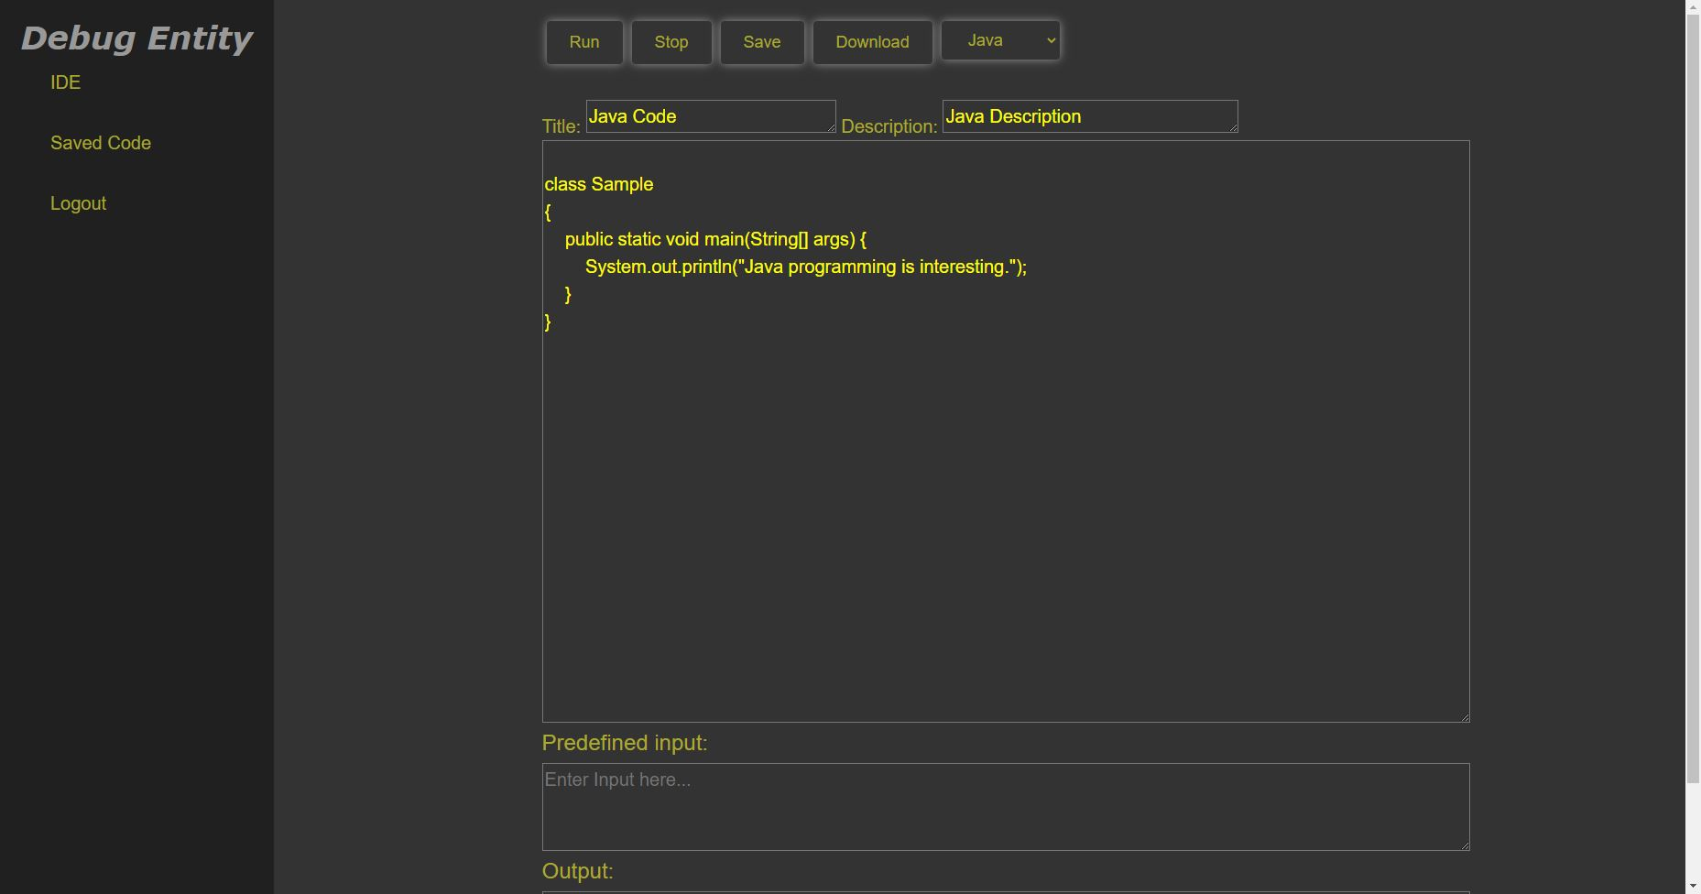
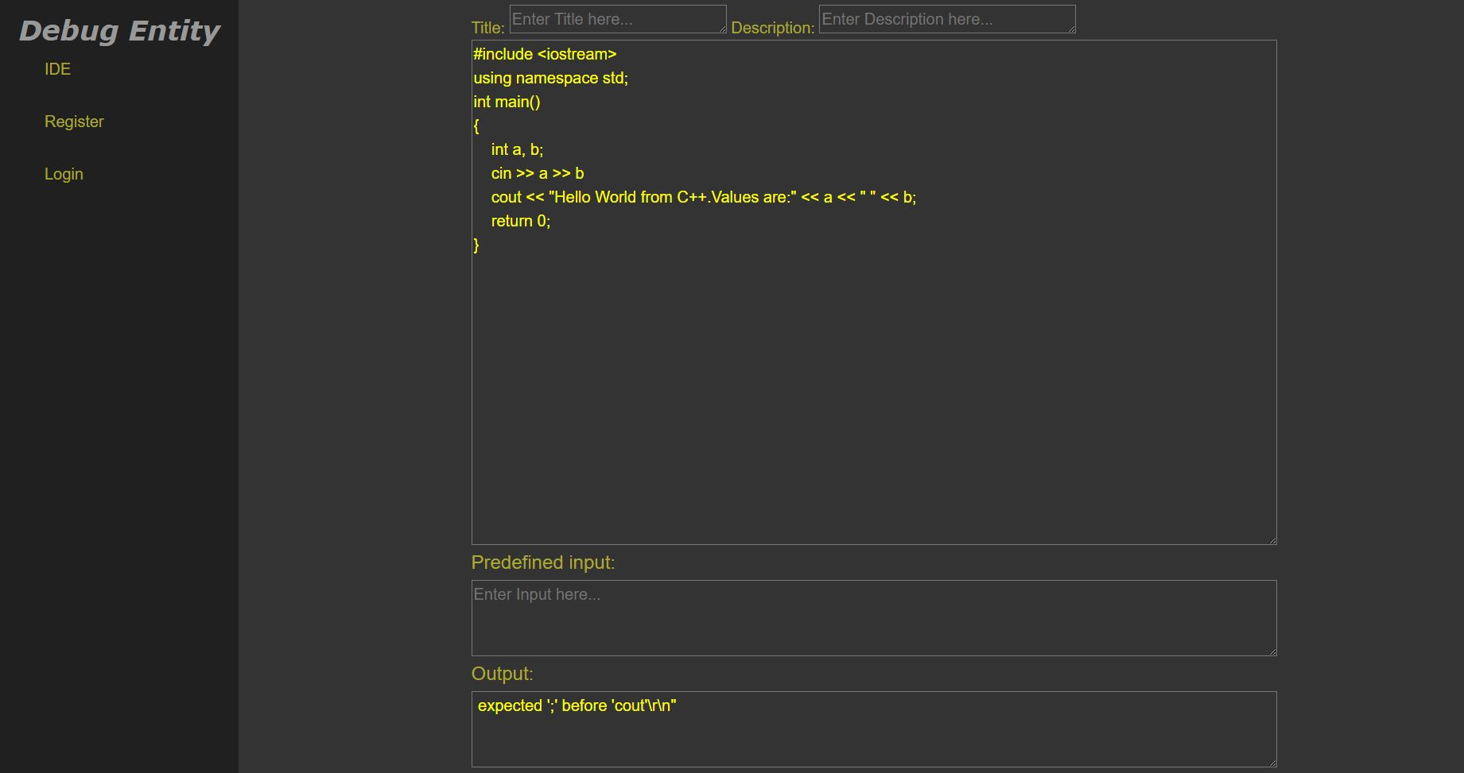
Download/Delete/Edit/Error
Download
Delete
Edit
Error

Slide 55
Retrospectives
What went well
Dived deeper on each task to prioritize it.
Successfully reduced the queue of backlogs by 74 percent.
Invested time paid off while planning and development as tasks in backlogs got reduced.
What needs improvement for future
Although we had good planning and development meeting, we still need everyone to provide more input during discussion and planning. More inputs/suggestion will improve the quality of the task/project.
Keep Jira task updated with progress and things to do.
Next Steps
For future
Follow the Scrum principles more thoroughly.
Start to discuss the progress on each task and re-prioritize or re-allocate the resources during the stand-up on daily basis.

Slide 56
Conclusion

Slide 57
Future Scope
We can add a discussion area where registered users can help each other with their difficulties in the code.
We can update our web application to make it more user friendly.
We can expand our application for compiling various other programming languages.
Implement strict privacy for user's data safety.

Slide 58
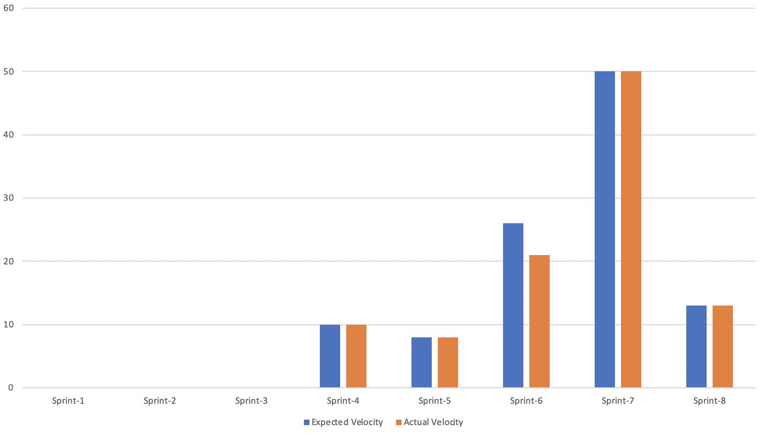
Velocity Report
This velocity report is based on story points.

Slide 59



GitHub Link
GitHub wiki
https://github.com/sg99356n/OnlineCC/wiki
Code Repository
https://github.com/sg99356n/OnlineCC

Slide 60
Demo

